Slide 1
Active Transportation Advisory Committee
JULY 8, 2026
PLANNING THE WAY WE MOVE

Slide 2
WELCOME
Please type your name, title, and what organization or municipality you are representing today into the chat.

Slide 3

Hybrid Meeting Guidelines
Mute your microphone
You can choose to use just the phone function
You can choose to turn your camera off if you want
Use Zoom’s chat function or “raise hand” if you have a question during the presentation
This meeting will be streamed to YouTube

Slide 4
AGENDA

Slide 5
Welcome & Introductions
Feature Presentation: The Economic Impact of the Empire State Trail
– Erica Schneider, Parks & Trails New York
Discussion items:
  2026 Walk, Bike, Roll New York Symposium Summary
  2025 Trail Count Program Report
  Hudson River Valley Greenway Conservancy Trail Grant Program
  Status of Planning Initiatives
Participant Updates
Upcoming Meetings

Slide 6
FEATURE PRESENTATION:
The Economic Impact of the
Empire State Trail
Erica Schneider, Parks & Trails New York

Slide 7

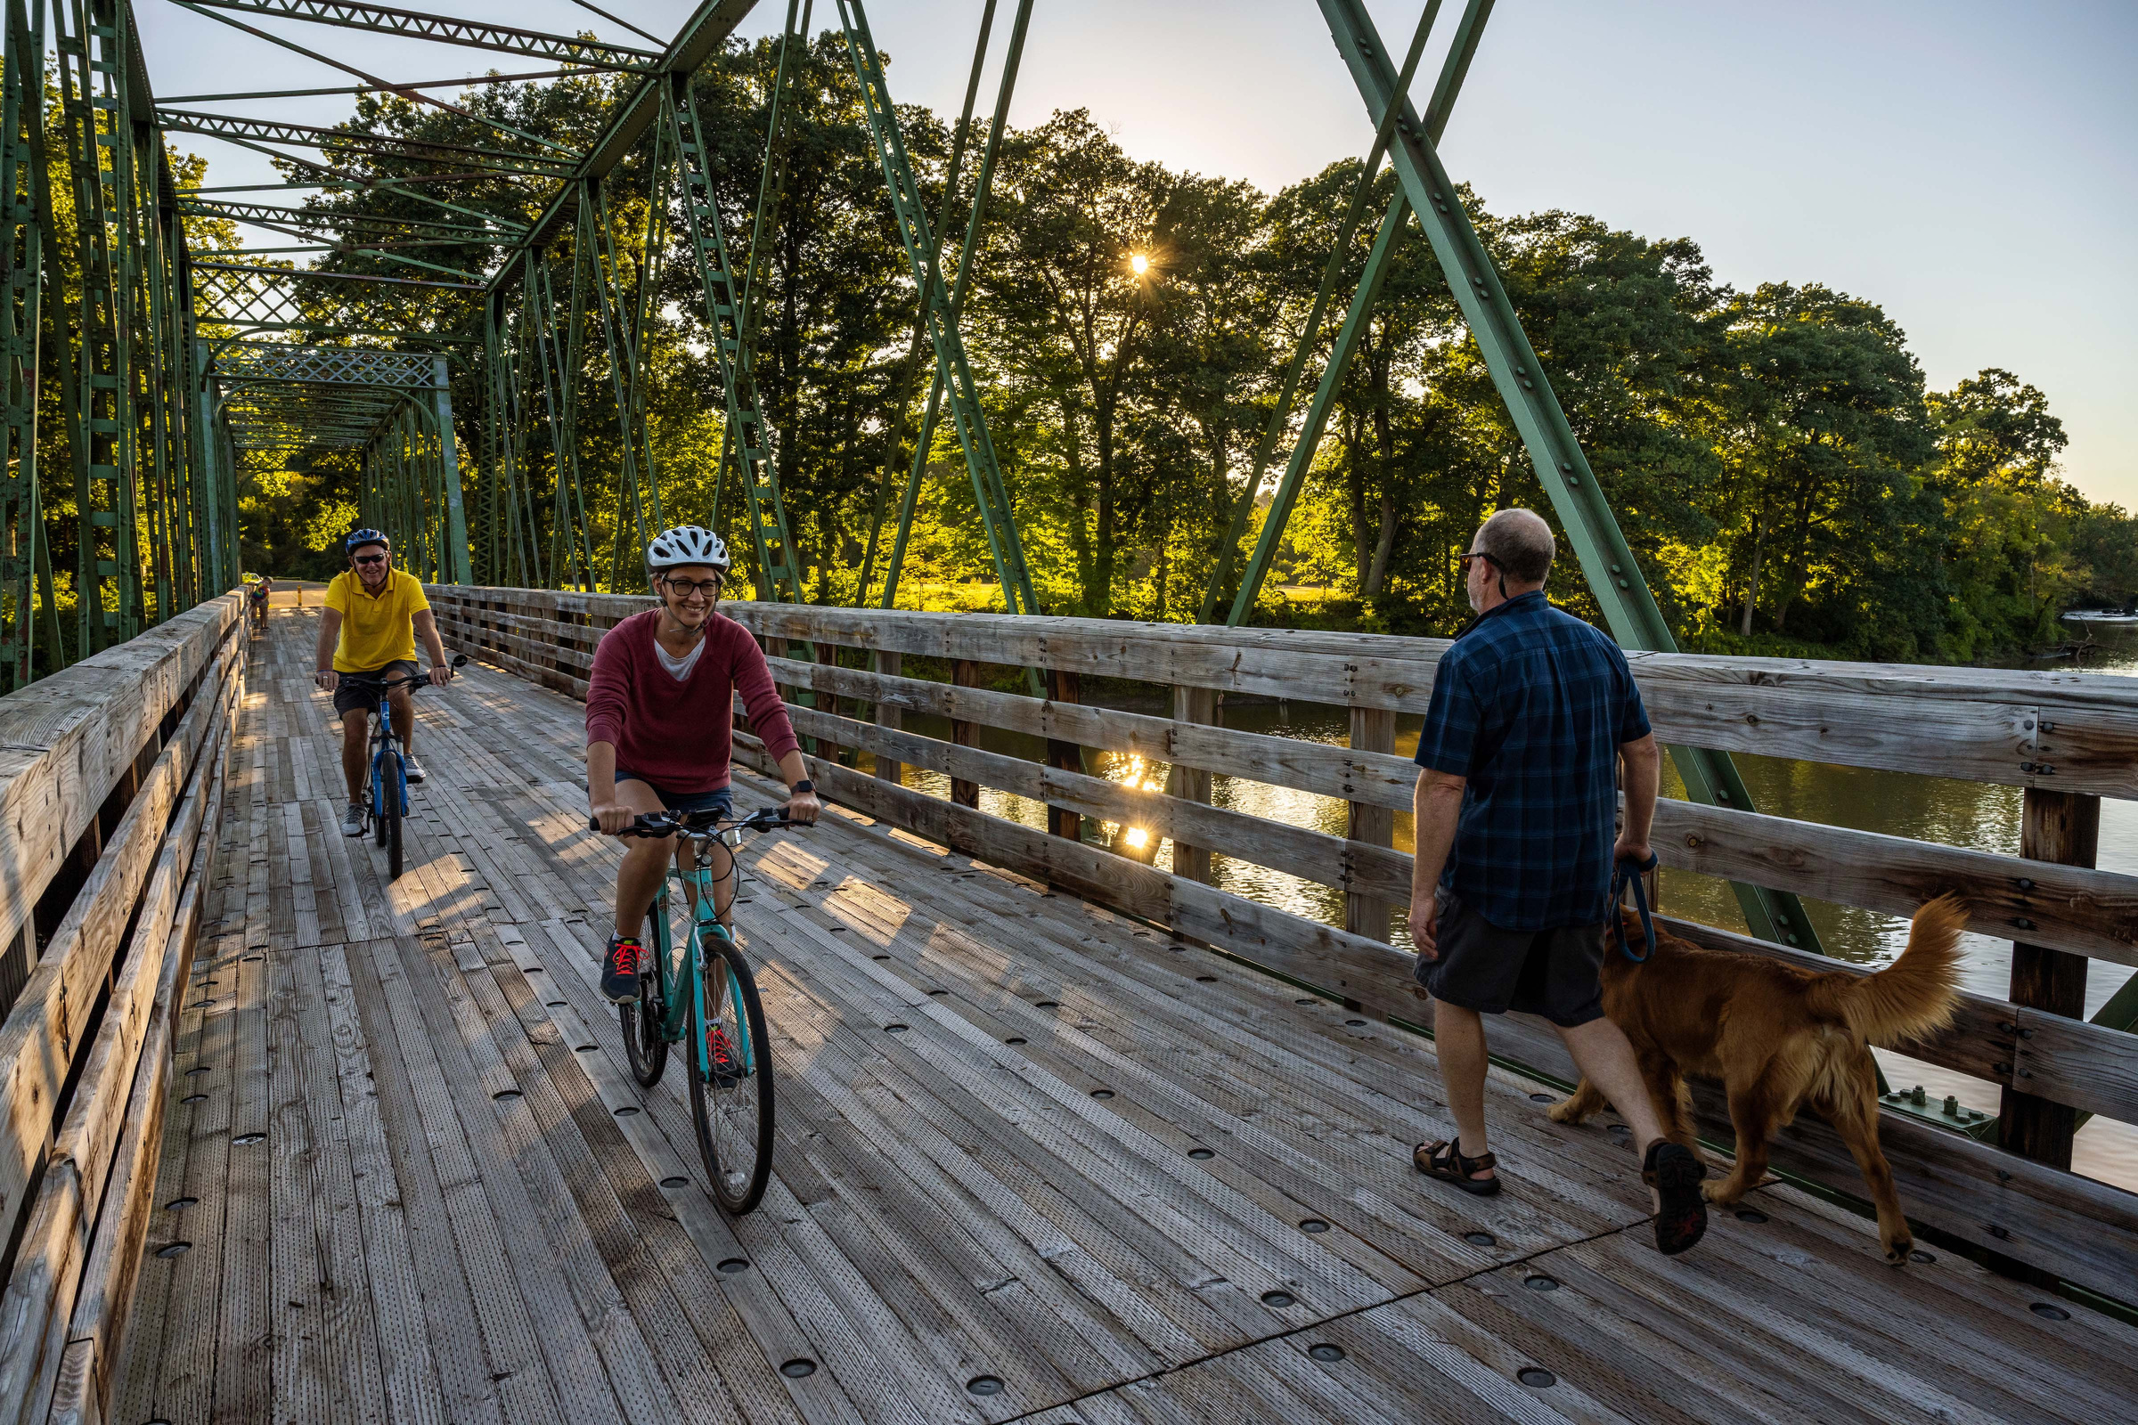

ECONOMIC IMPACT OF THE EMPIRE STATE TRAIL
CRTC Active Transportation Advisory Committee
July 8, 2026
Champlain Valley Trail

Slide 8




WHAT WE DO
PARKS & TRAILS NEW YORK
MULTI-DAY BIKE TOURS
GROW TRAILS AND MAKE THEM SAFER
PUBLIC LANDS STEWARDSHIP
GUIDE TRAIL TOWNS
We host two cross-state bike tours each summer, Cycle the Erie Canal and Cycle the Hudson Valley.
We host thousands of volunteers each year across the state at Canal Clean Sweep & I Love My Park Day events.
We support trail-side towns to embrace the economic and cultural value of greenways.
We work to expand New York’s trail network and increase access through advocacy, trail counts, & more.

Slide 9




OUR PARTNERS

Slide 10



THE RESEARCH TEAM
Project management, public engagement, report development
Data analysis
Trail visitation estimates

Slide 11
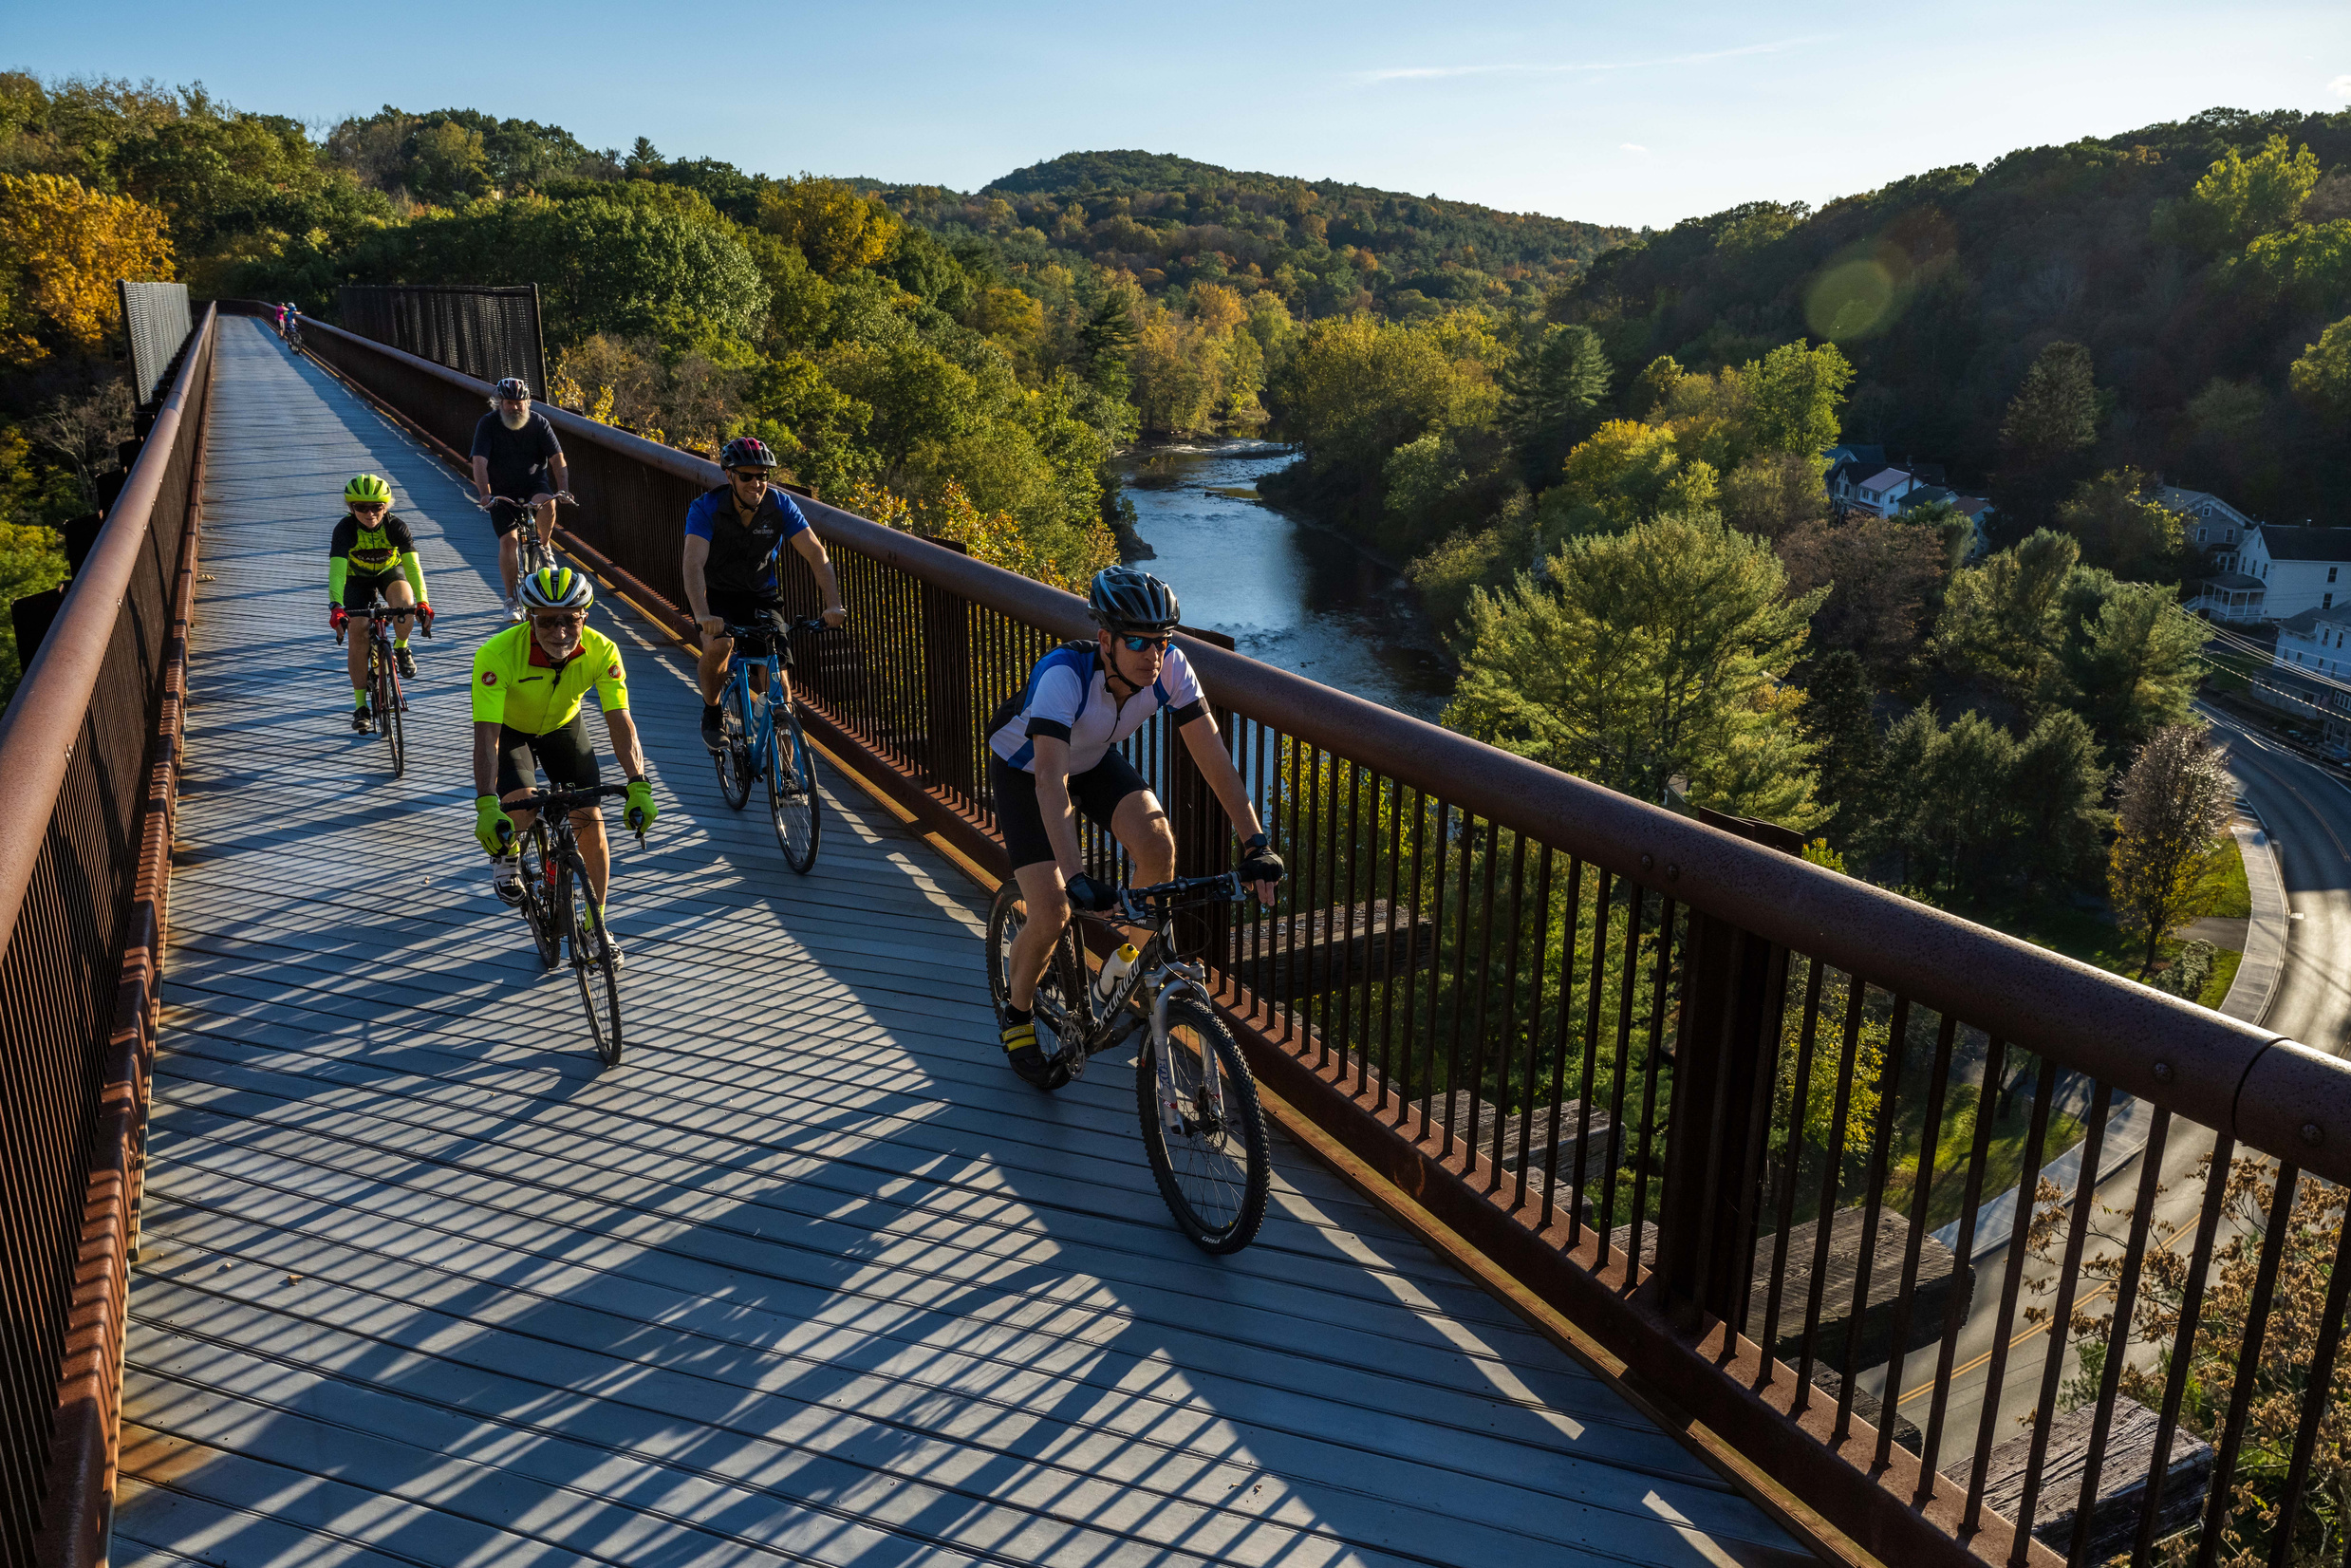
PROJECT PURPOSE, NEEDS & GOALS
Our goal with this report was to understand the impact of the Empire State Trail on New York’s economy, environment, and public health.
The results of this study will serve as a critical tool for policymakers, advocates, and stakeholders, providing credible data to support future investments in trail infrastructure and programming. It will also underscore the trail’s significance as a catalyst for community development and economic prosperity.
Hudson River Valley Greenway

Slide 12
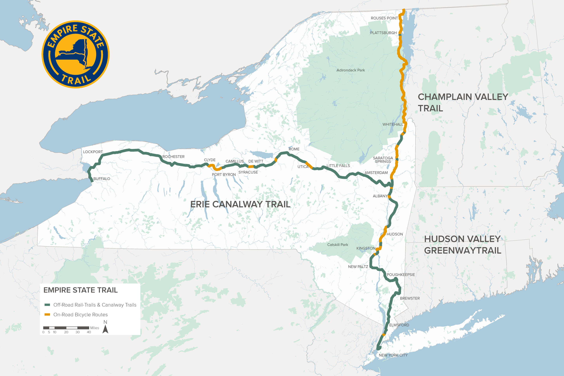
THE EMPIRE STATE TRAIL

Slide 13
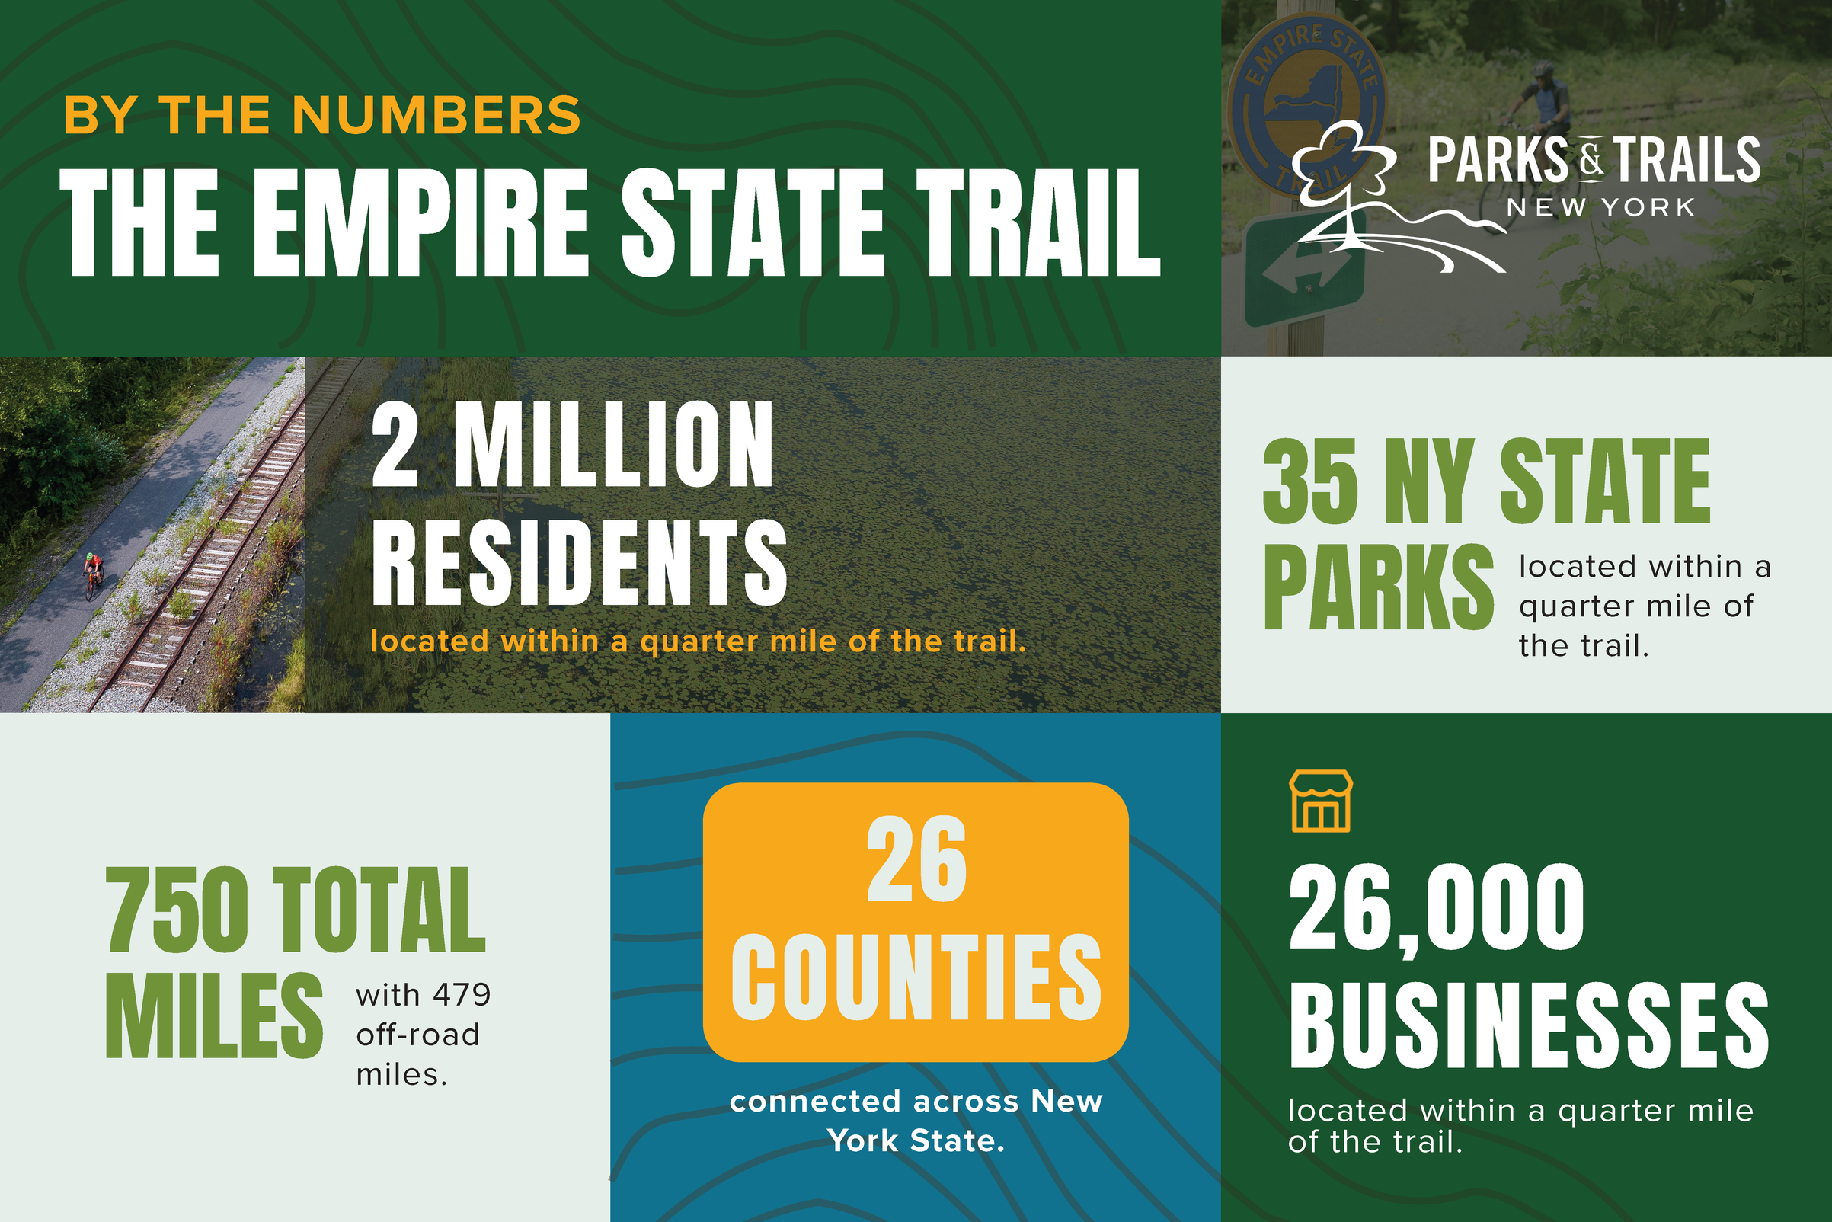

Slide 14
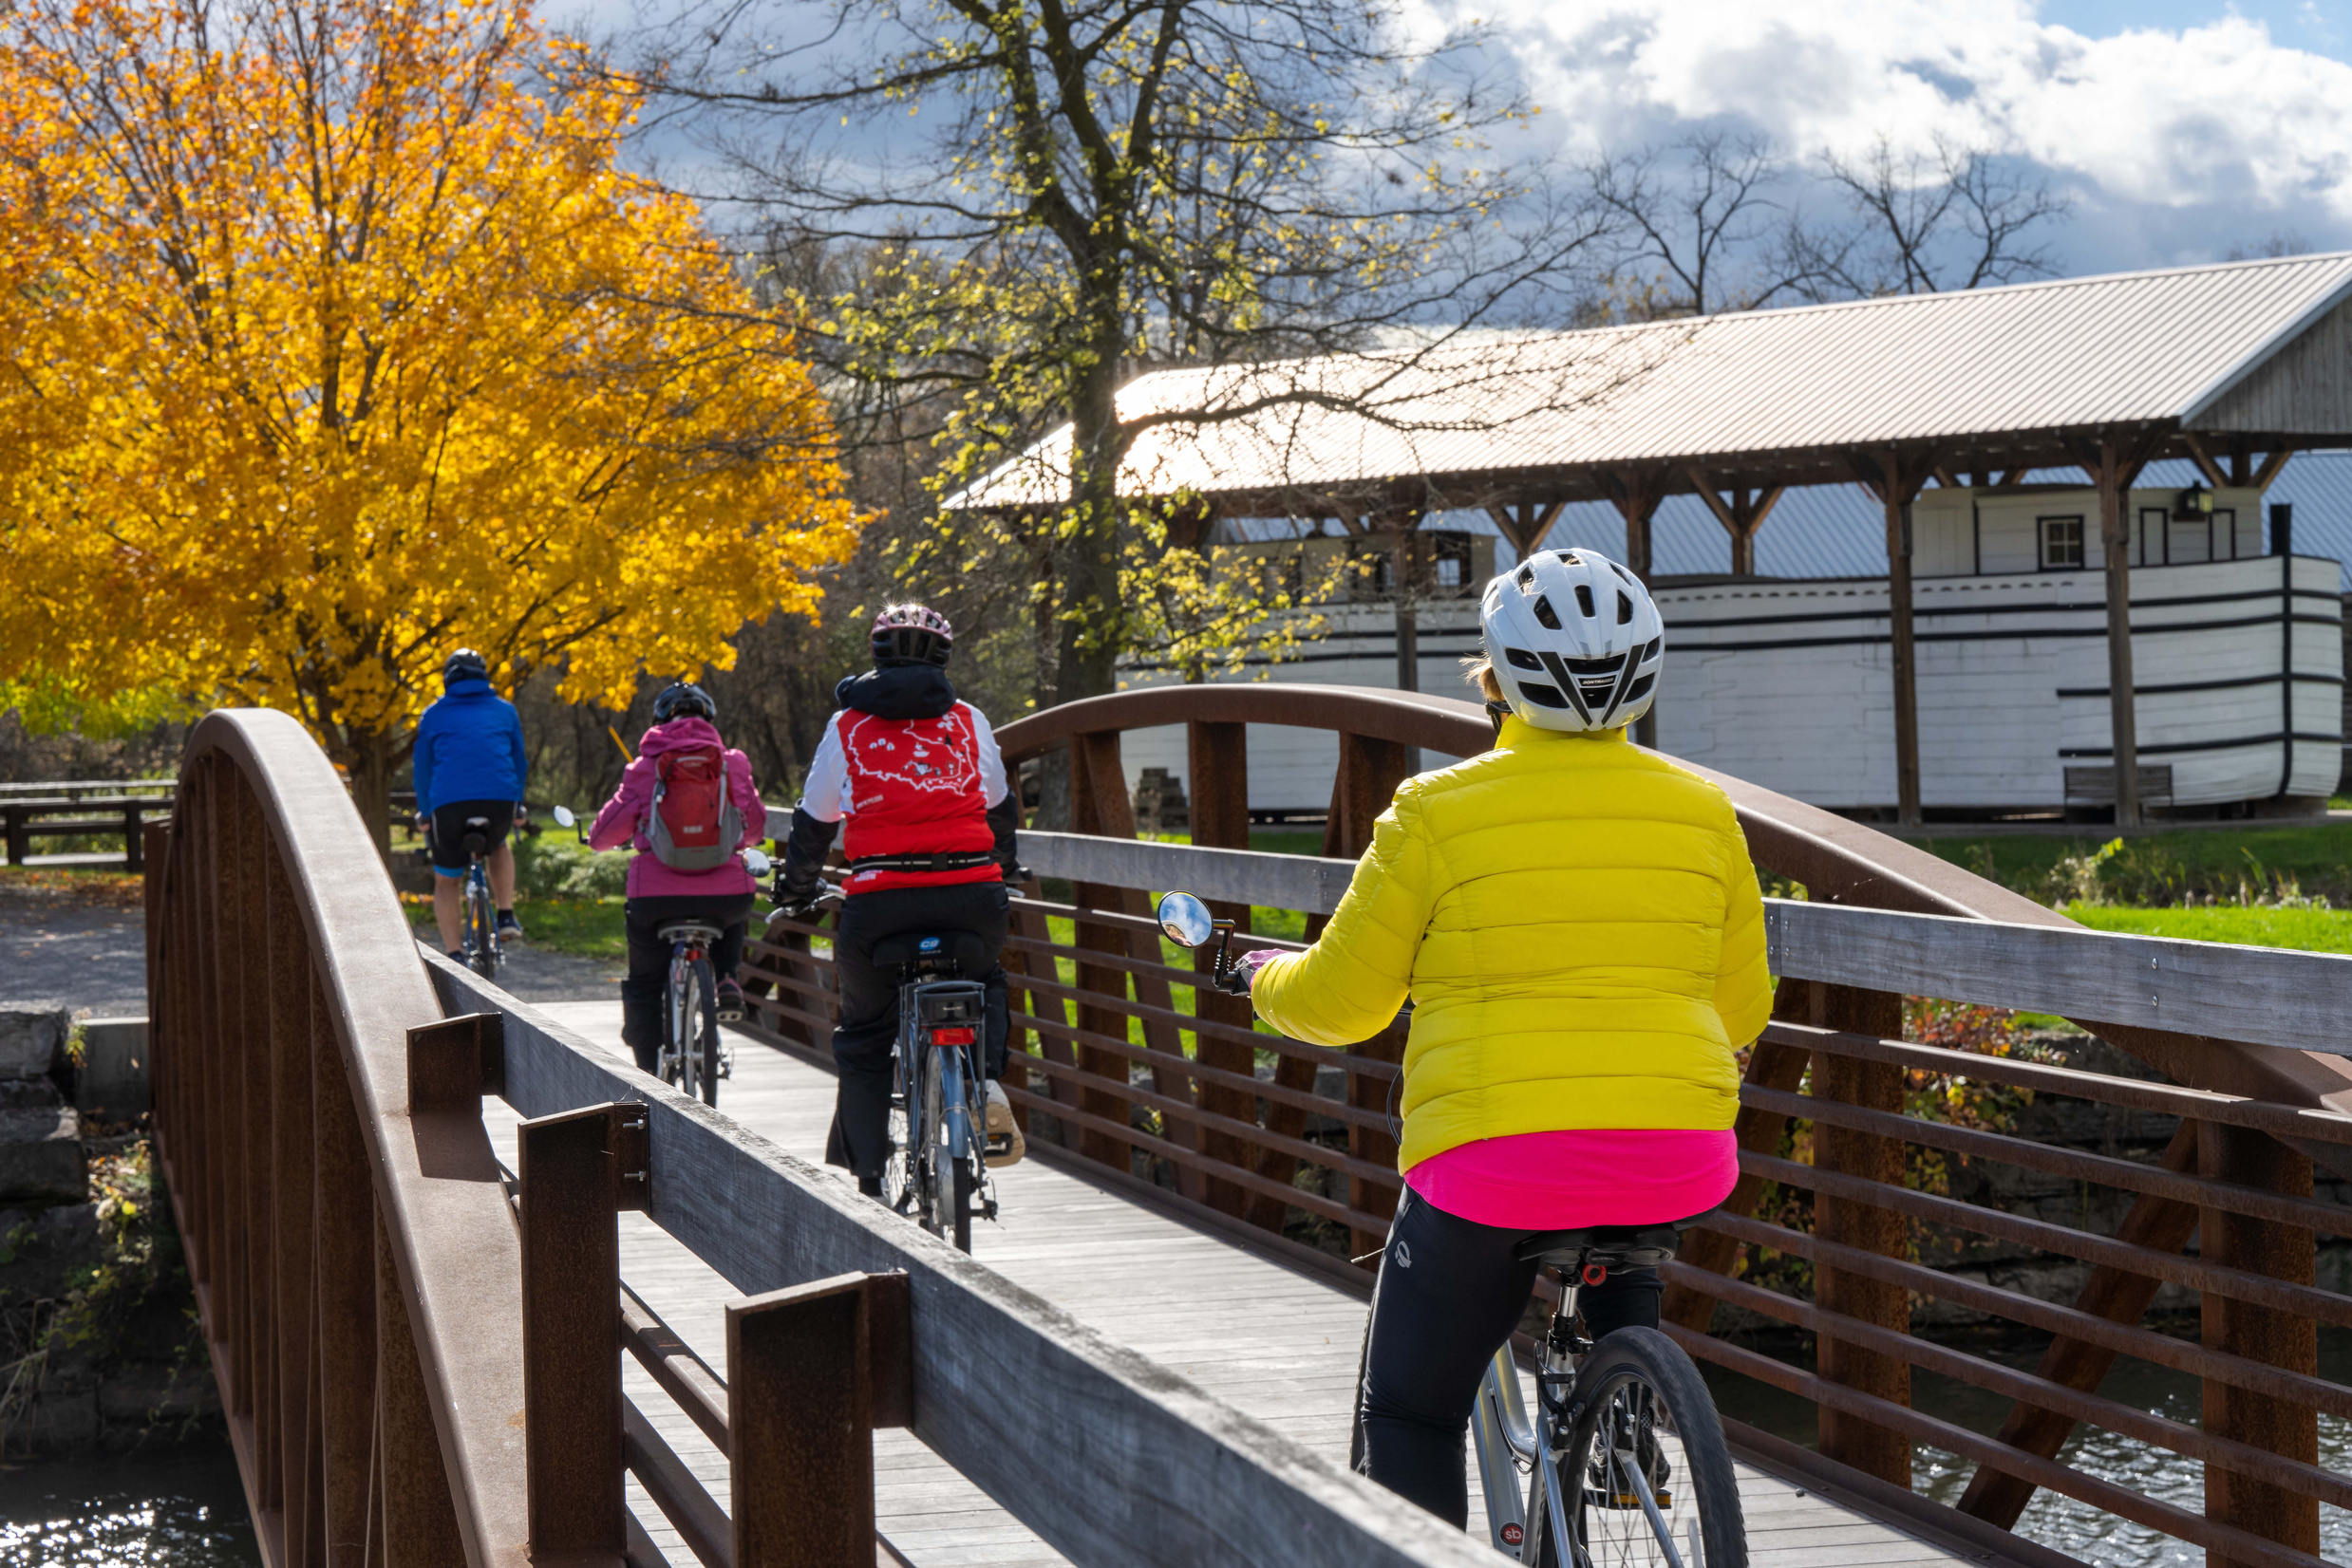
UNDERSTANDING THE TRAIL

Slide 15
THE EMPIRE STATE TRAIL

Slide 16
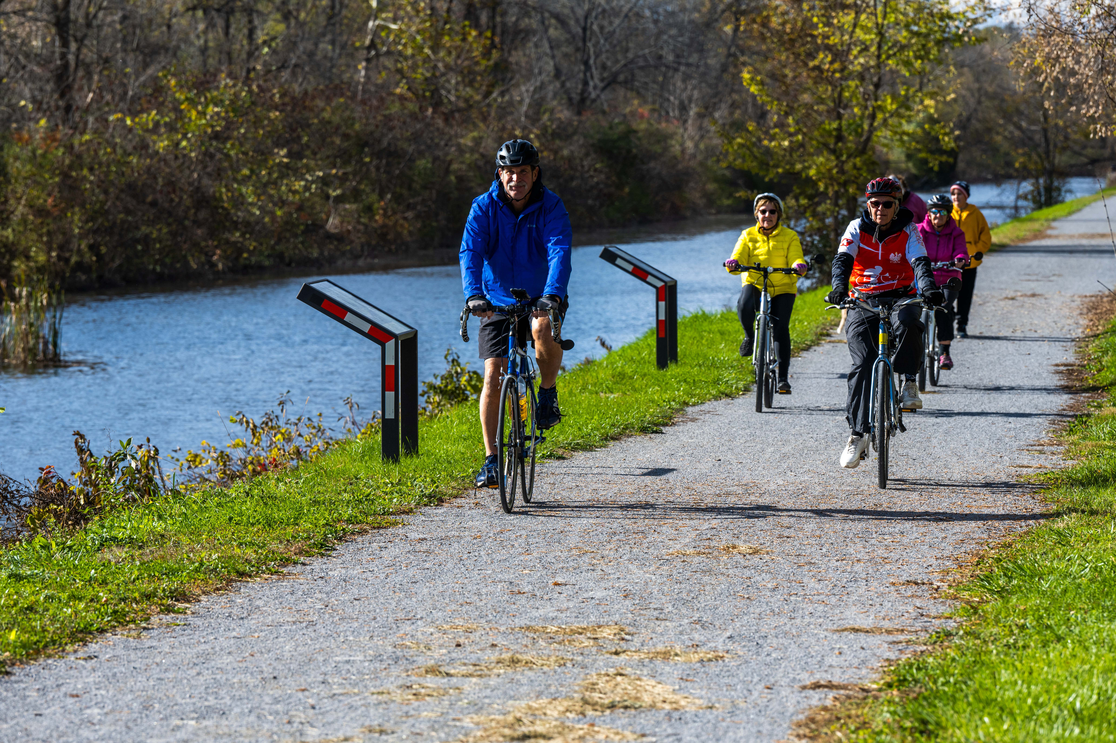
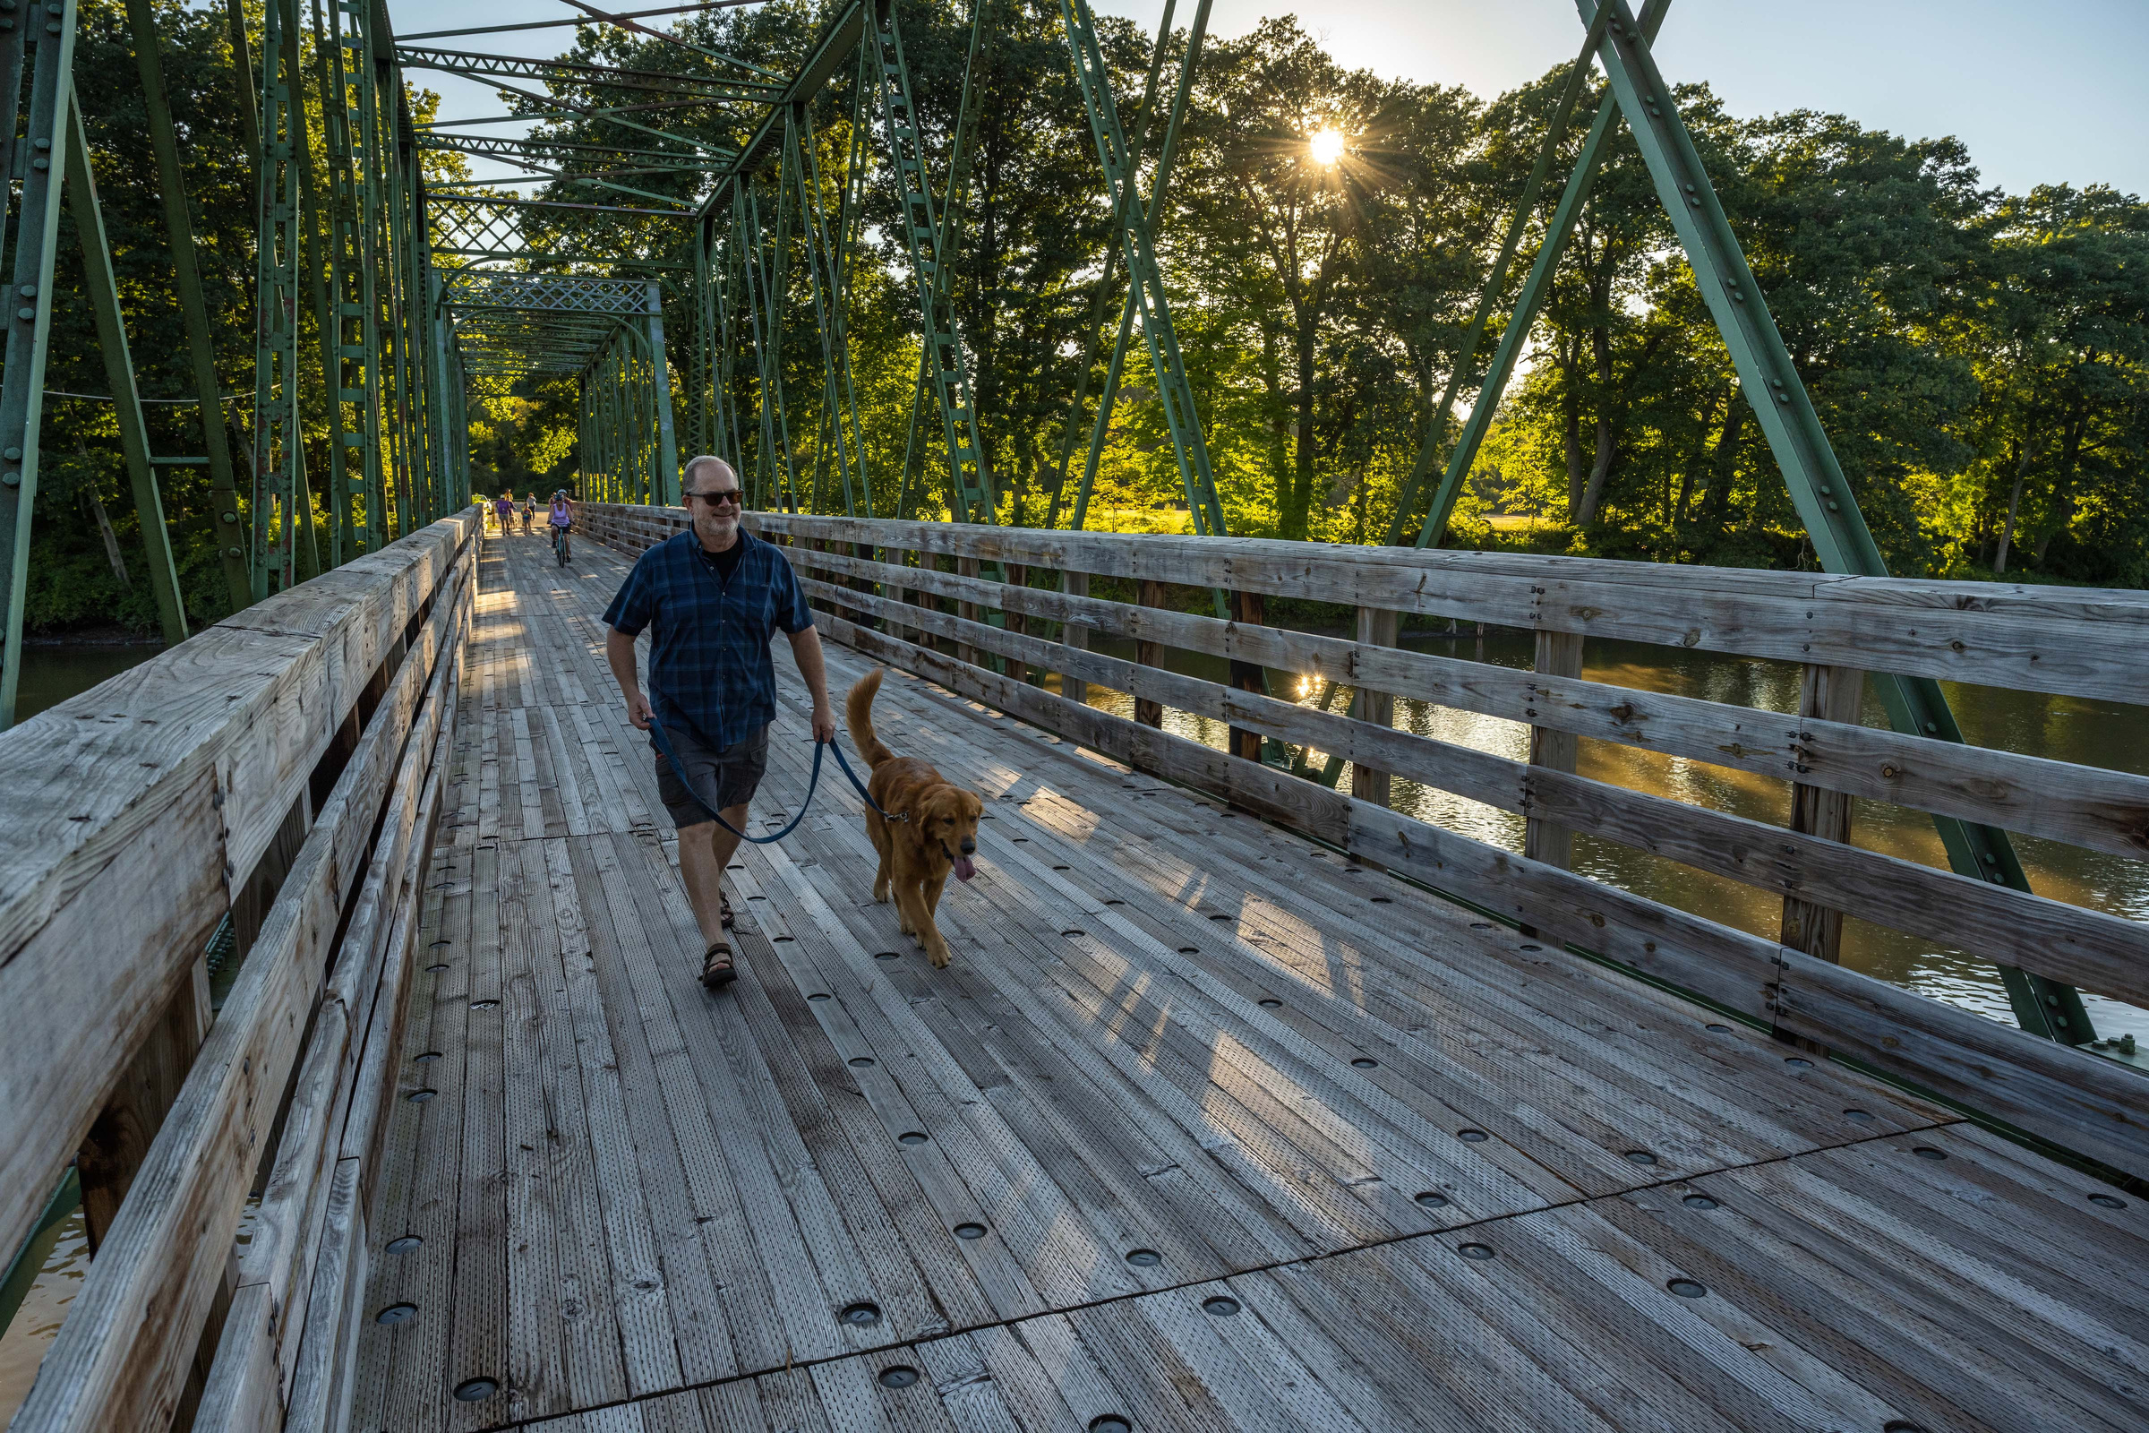
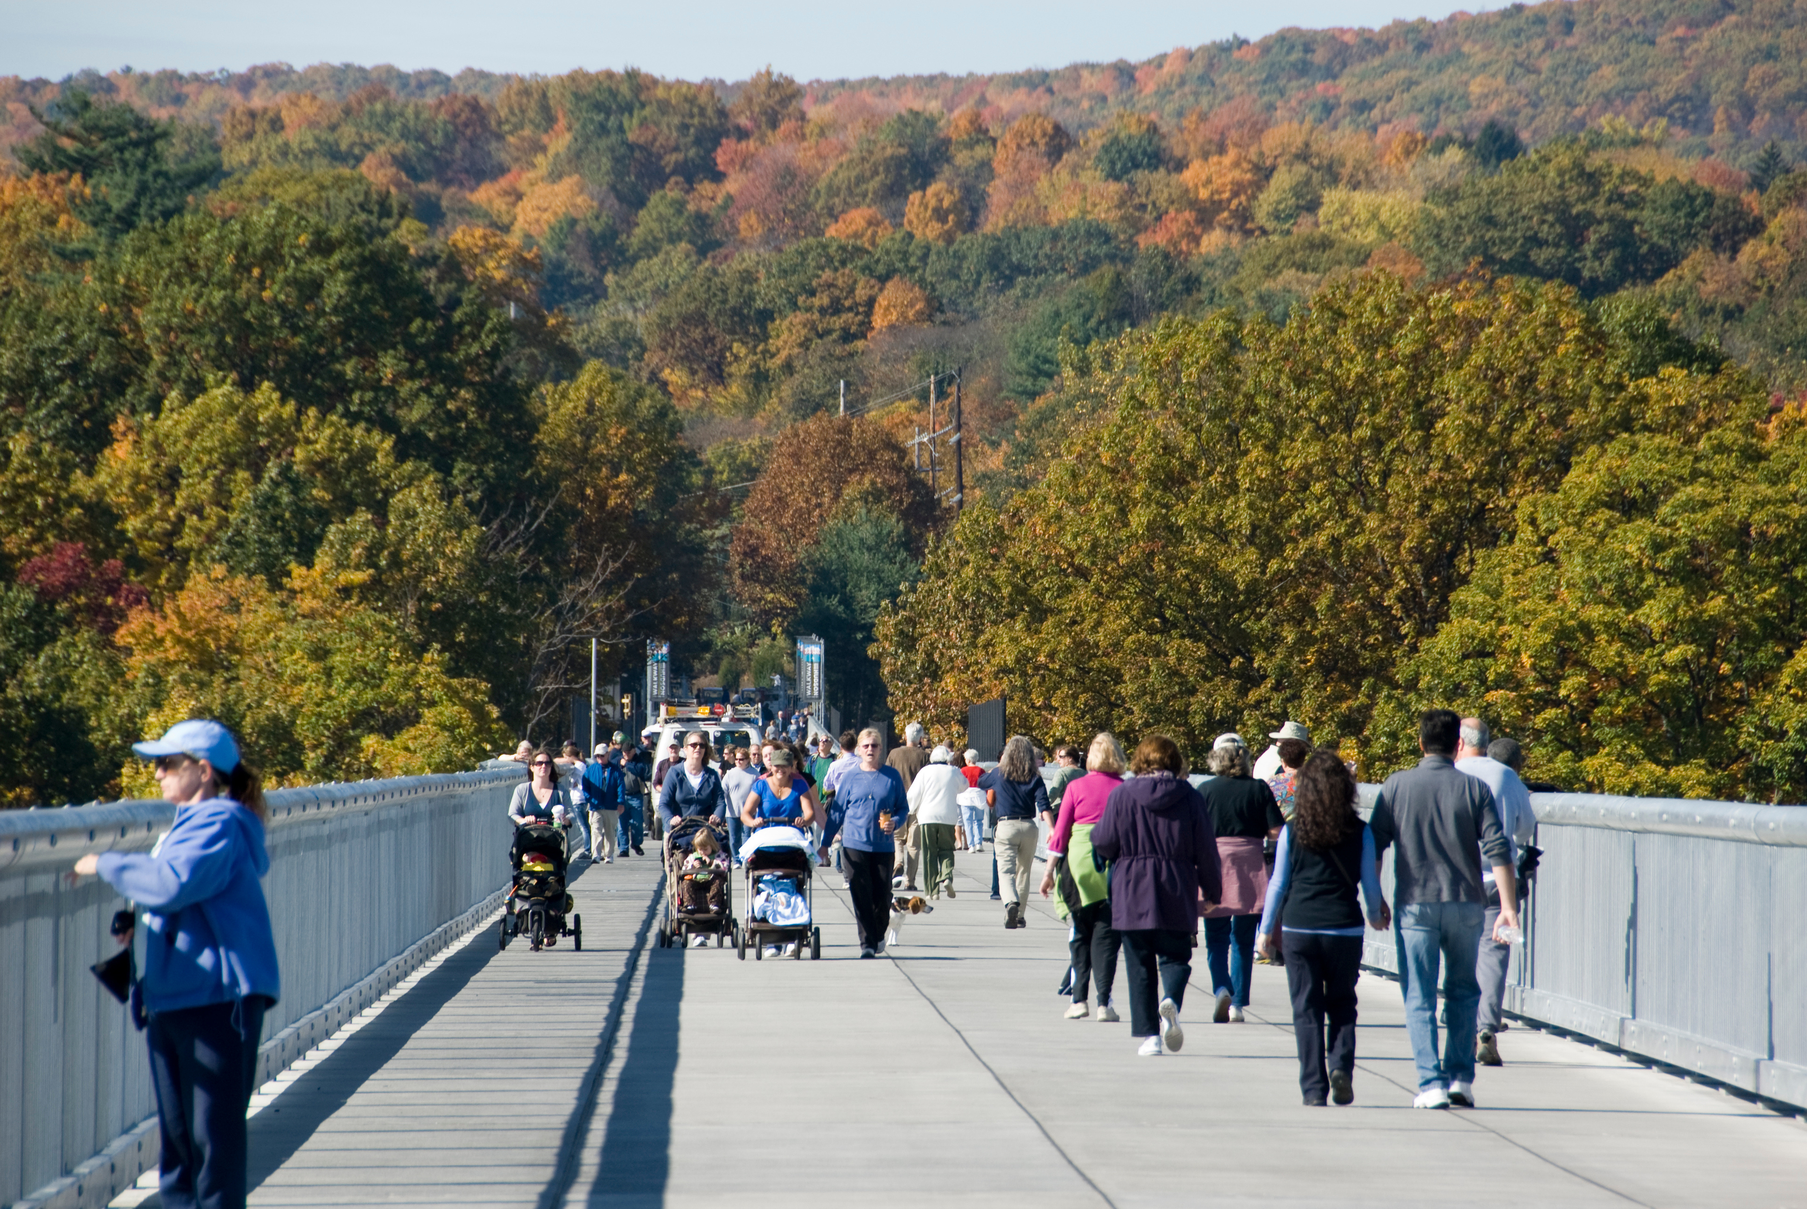
THE EMPIRE STATE TRAIL
THE EMPIRE STATE TRAIL
THE EMPIRE STATE TRAIL
BUFFALO TO ALBANY
ALBANY TO THE CANADIAN BORDER
NEW YORK CITY TO ALBANY

Slide 17
THE EMPIRE STATE TRAIL
THE EMPIRE STATE TRAIL
THE EMPIRE STATE TRAIL
BUFFALO TO ALBANY
ALBANY TO THE CANADIAN BORDER
NEW YORK CITY TO ALBANY
The longest and oldest segment of the Trail, with conversation of the Erie Canalway towpath beginning in the 1970s.

Slide 18
THE EMPIRE STATE TRAIL
THE EMPIRE STATE TRAIL
THE EMPIRE STATE TRAIL
BUFFALO TO ALBANY
ALBANY TO THE CANADIAN BORDER
NEW YORK CITY TO ALBANY
Of the three segments, this Trail presents the greatest opportunity for investment in additional off-road infrastructure.

Slide 19
THE EMPIRE STATE TRAIL
THE EMPIRE STATE TRAIL
THE EMPIRE STATE TRAIL
BUFFALO TO ALBANY
ALBANY TO THE CANADIAN BORDER
NEW YORK CITY TO ALBANY
First established in 1991, the Greenway is the most-visited trail in the United States.

Slide 20
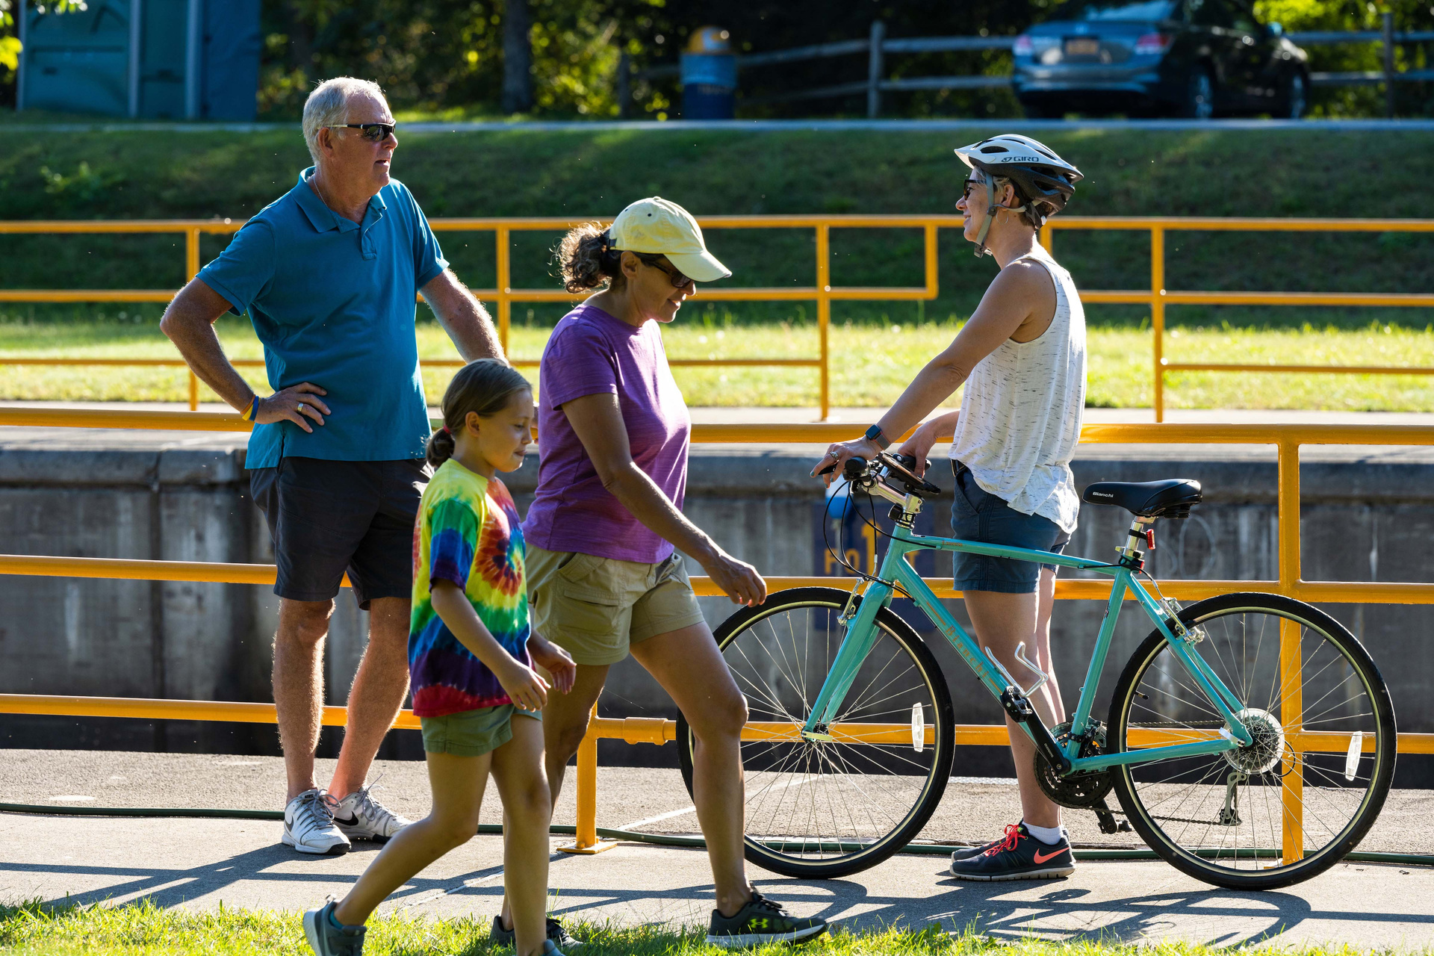
PUBLIC ENGAGEMENT & VISIT COUNTS
August-November 2025
Public Engagement
June 2026
Findings Released
Summer 2025
Project Initiation
December-April 2026
Data Analysis

Slide 21
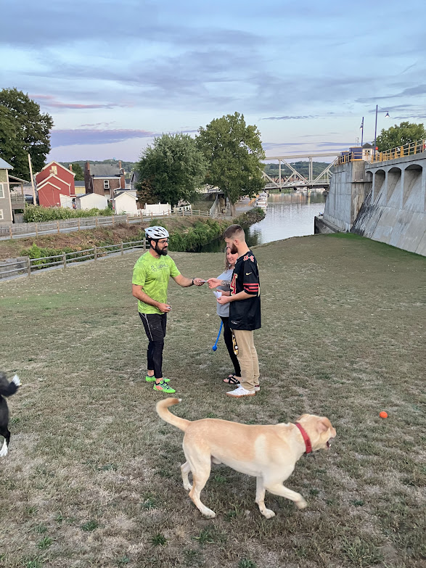
SURVEY COLLECTION
Intercept Surveys
Completed on the Trail via a team of Volunteers and Staff coordnated by PTNY and LaBella Associates
Long-Form Survey
A more robust survey completed online via links found on websites, emails, social media, and physical posters and business cards at locations on the trail
Business Surveys
Disbursed via directories of trail local businesses and county and local chamber of commerce networks

Slide 22
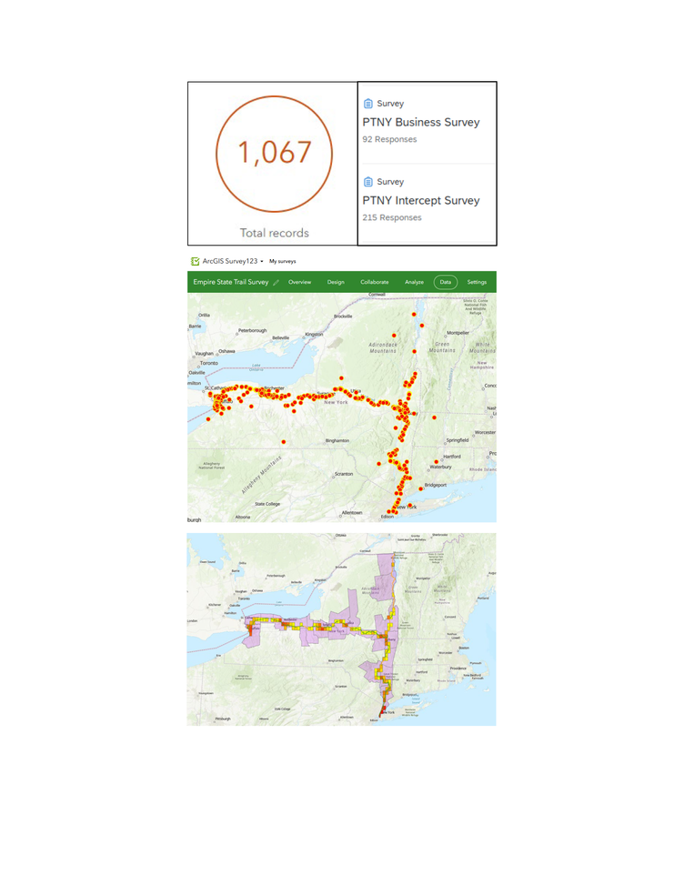
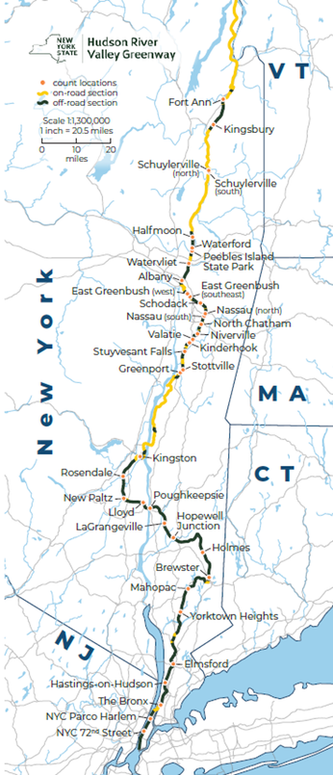
RESEARCH METHODS
ECONOMIC IMPACT
VISITATION ESTIMATES
SURVEYS
EXPENDITURE PROFILES
GIS ANALYSES
ECONOMIC MODELING (IMPLAN I-0)
TRAIL COUNT DATA
CORRIDOR ANALYSES
VISITATION ESTIMATES

Slide 23
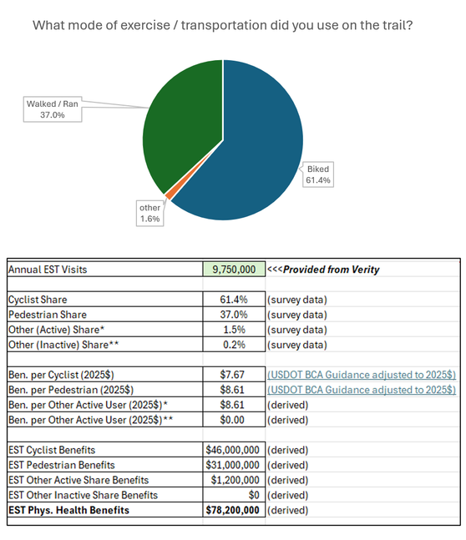
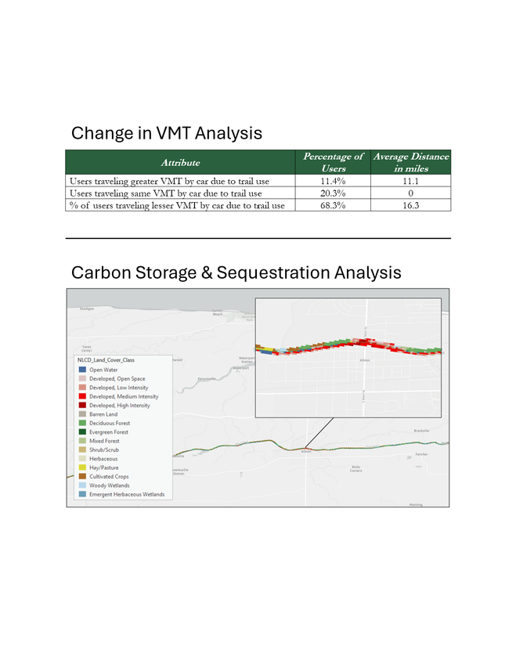
RESEARCH METHODS
PHYSICAL HEALTH
ENVIRONMENTAL BENEFITS
SURVEYS
PHYSICAL ACTIVITY
PROFILES
MONETIZATION
ALTERNATIVE TRIP ANALYSIS
GIS LAND PRESERVATION ANALYSIS
Reductions in vehicle miles traveled
Carbon storage and sequestration
*Other active trip responses included paddling, horseback riding, rollerblading, and roller skating and encompassed 90 percent of the other modes used on the trail.
**Other inactive trip responses included mobility scooters and encompassed 10 percent of other modes used on the trail.

Slide 24
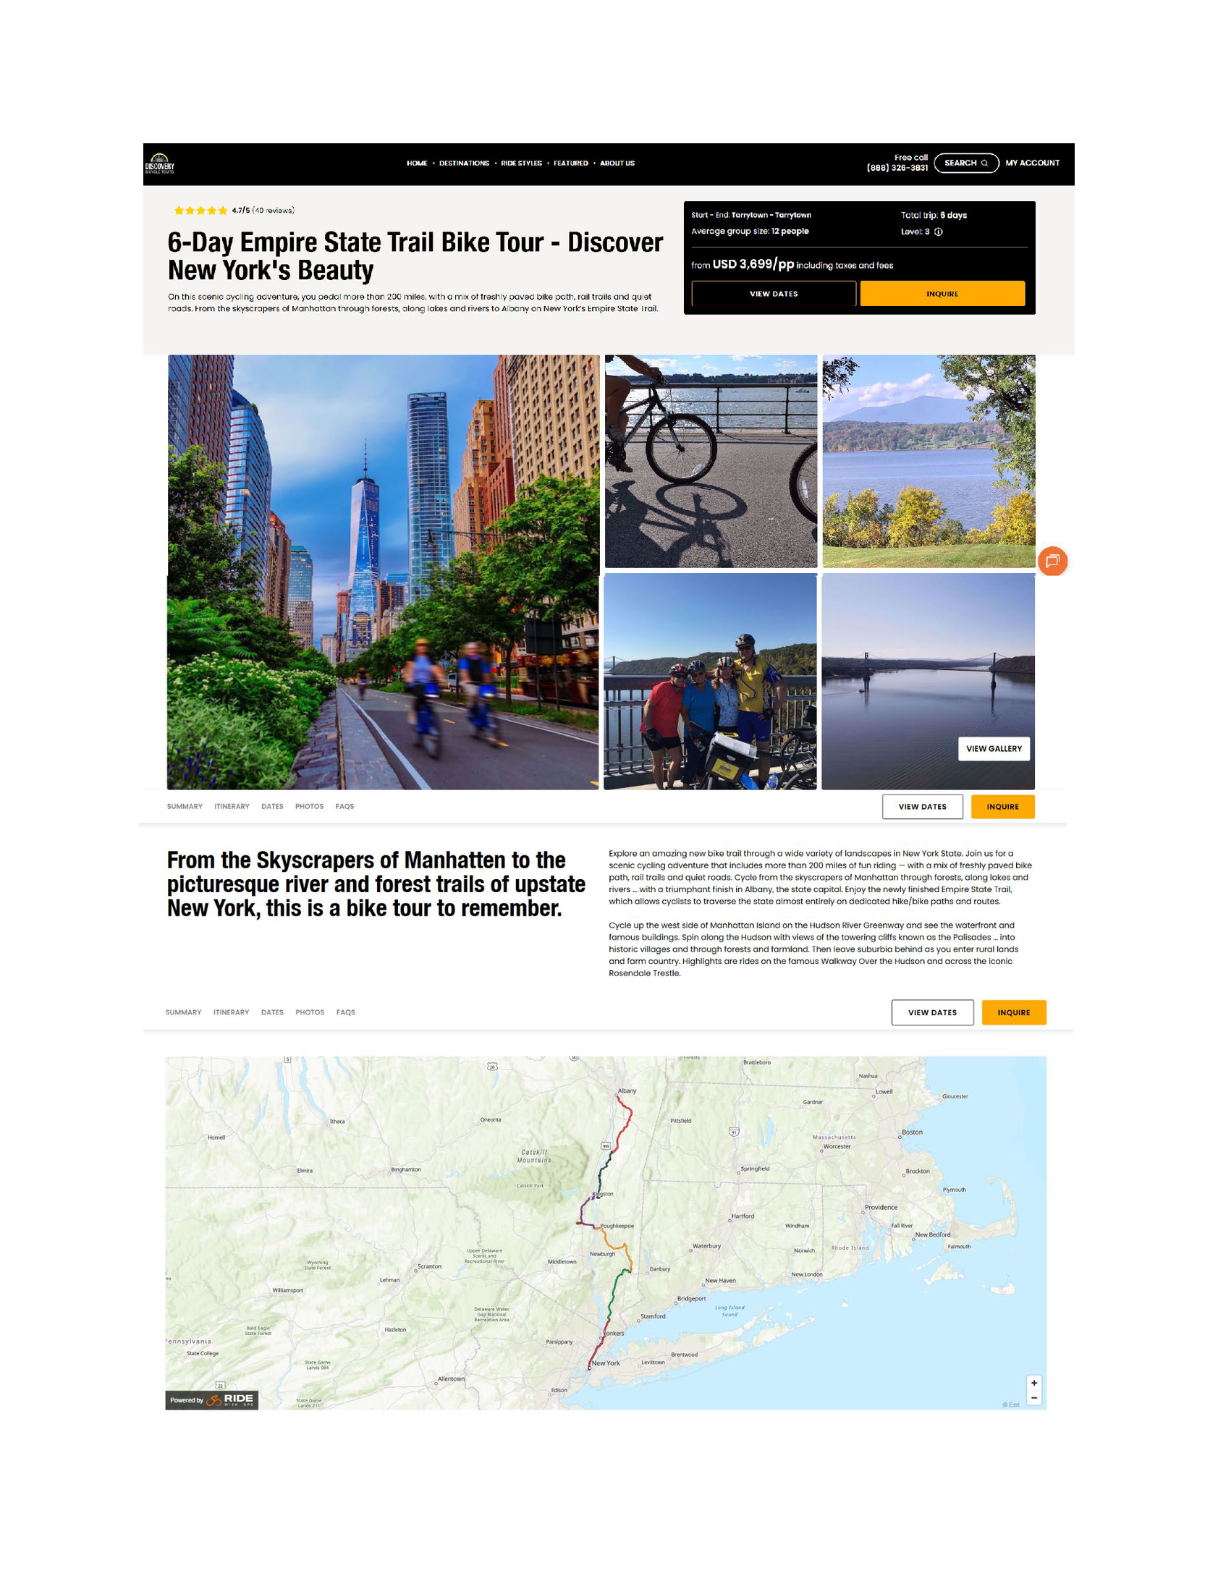
Institute for Transportation Research & Education (ITRE)
ECONOMIC IMPACTS
Photo Credit: Discovery Bicycle Tours.

Slide 25
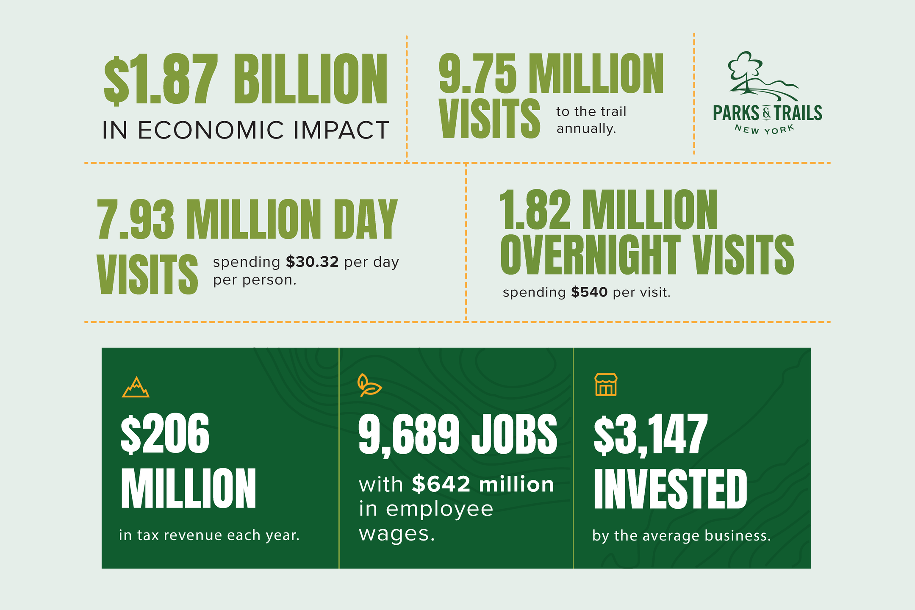

Slide 26

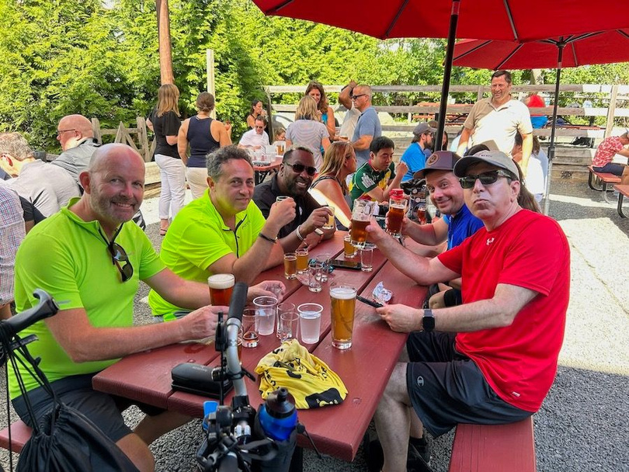
ECONOMIC IMPACTS
With more than 44,000 businesses located within one-quarter mile of the trail, visitors have convenient access to restaurants, lodging, retail, and services that benefit from trail-related spending.
Photo Credit: Bruce Robertson, Cycle Tours Global.
40.9% OF PROXIMATE BUSINESSES MAKE TRAIL-RELATED INVESTMENTS.*
DAILY TRAIL USERS SPEND AND AVERAGE OF $30.32 PER TRAIL VISIT.
OVERNIGHT TRAIL USERS SPEND AN AVERAGE OF $539.38 PER TRIP.
Spending an average of $3,147 /year
*40.9% of proximate businesses have invested in their location, facilities, or operations based on survey responses from businesses located within one-quarter mile of the Empire State Trail. Investments include physical improvements (e.g., signage, bike racks, and trail-access enhancements) as well as location-related costs, such as paying a premium to operate near the trail and its users.

Slide 27
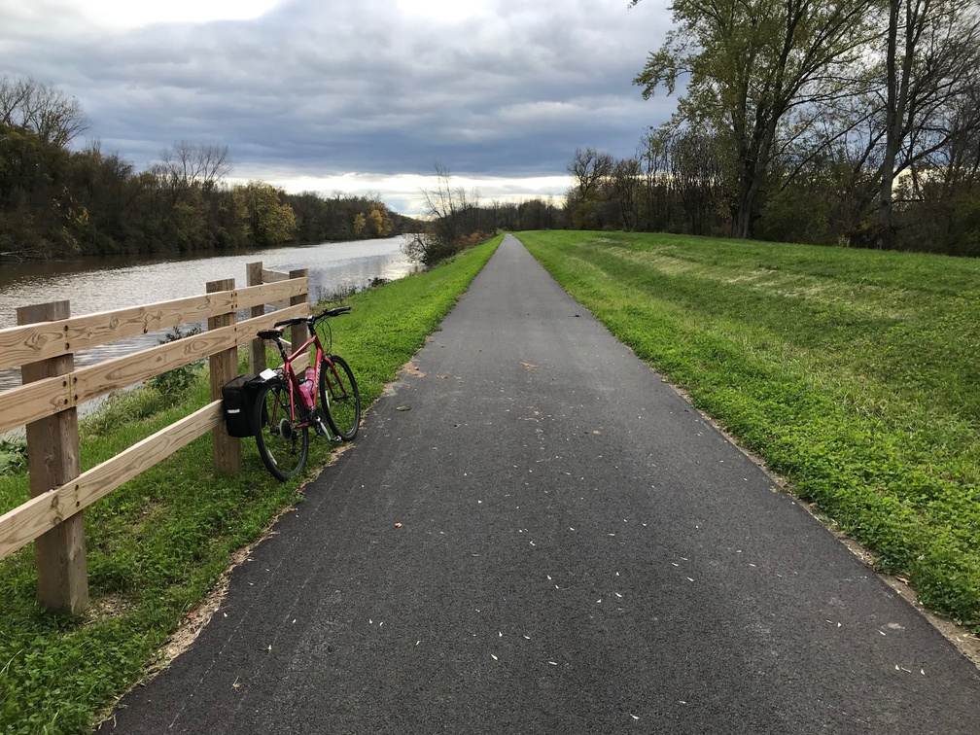
ECONOMIC IMPACTS
EVERY $1 INVESTED IN THE EMPIRE STATE TRAIL RETURNS $5.43 IN SALES REVENUE.
OFF‑ROAD SEGMENTS OF THE TRAIL GENERATE 4X THE ECONOMIC IMPACT OF ON‑ROAD SEGMENTS.
EACH OFF-ROAD MILE OF THE EMPIRE STATE TRAIL IS ESTIMATED TO PRODUCE $3.9 MILLION IN ANNUAL ECONOMIC OUTPUT.

Slide 28


With an estimated 9.75 million annual visits, the Empire State Trail supports approximately 9,700 jobs, $640.9 million in employee earnings, more than $1.8 billion in economic output, and $205.7 million in state and local tax revenue.
ECONOMIC
IMPACTS
ERIE CANALWAY TRAIL
CHAMPLAIN VALLEY TRAIL
HUDSON VALLEY GREENWAY TRAIL
3.6 MILLION VISITS
526,000 VISITS
5.6 MILLION VISITS
3.5K
530
5.6K
Jobs
Jobs
Jobs
$234.1M
$35.2M
$371.5M
Wages
Wages
Wages
$687.4M
$101.6M
$1.1B
Economic Output
Economic Output
Economic Output
$75.4M
$11M
$119.4M
State & Local Taxes
State & Local Taxes
State & Local Taxes

Slide 29
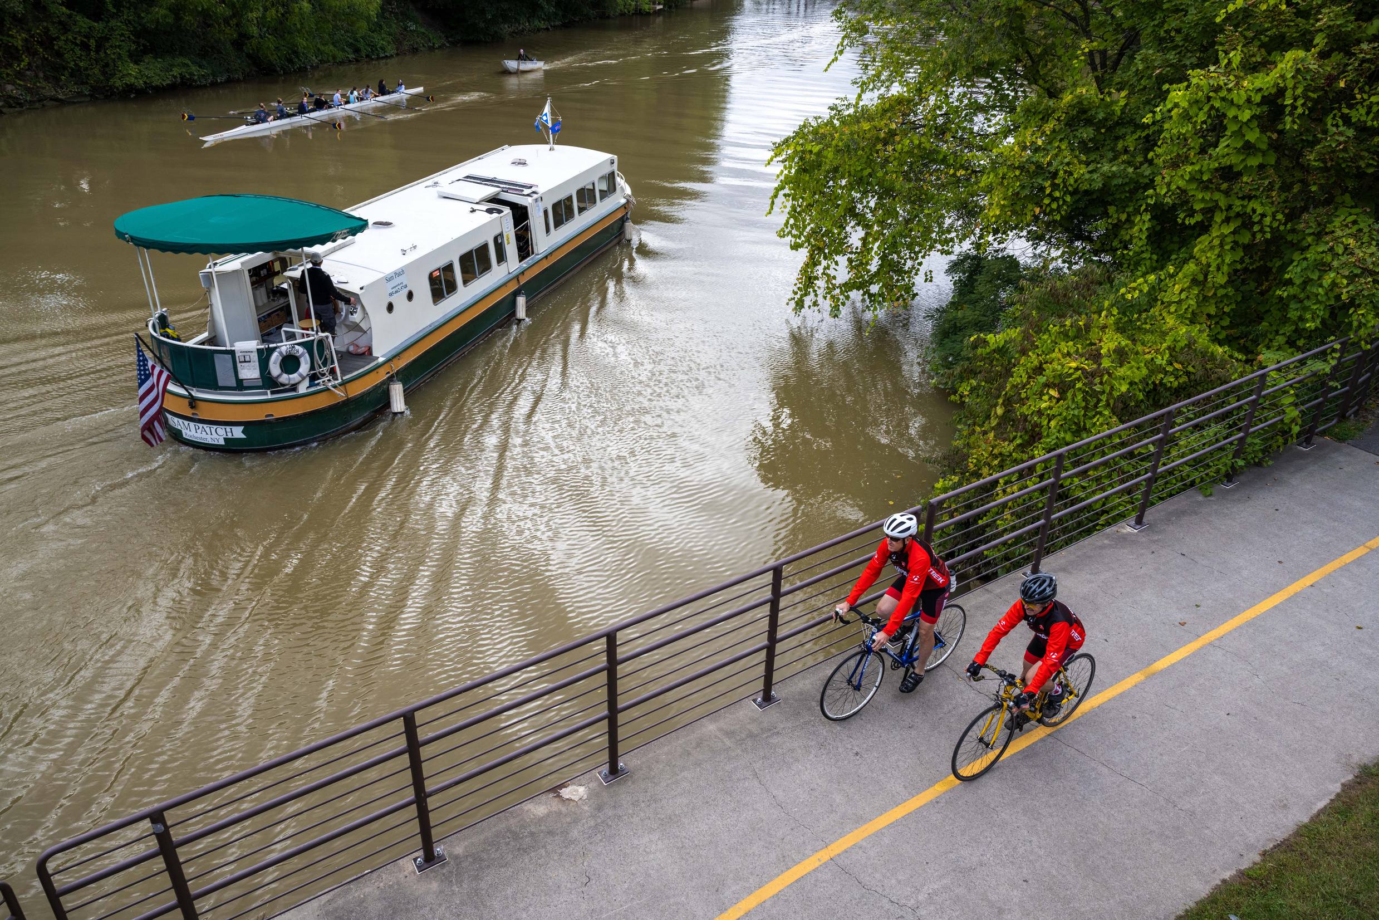
LaBella Associates
ENVIRONMENTAL BENEFITS & PHYSICAL HEALTH
Notes:
By making outdoor activity accessible to millions, the Trail allows New Yorkers to lead healthier lives while helping communities mitigate the real costs of environmental degradation.

Slide 30
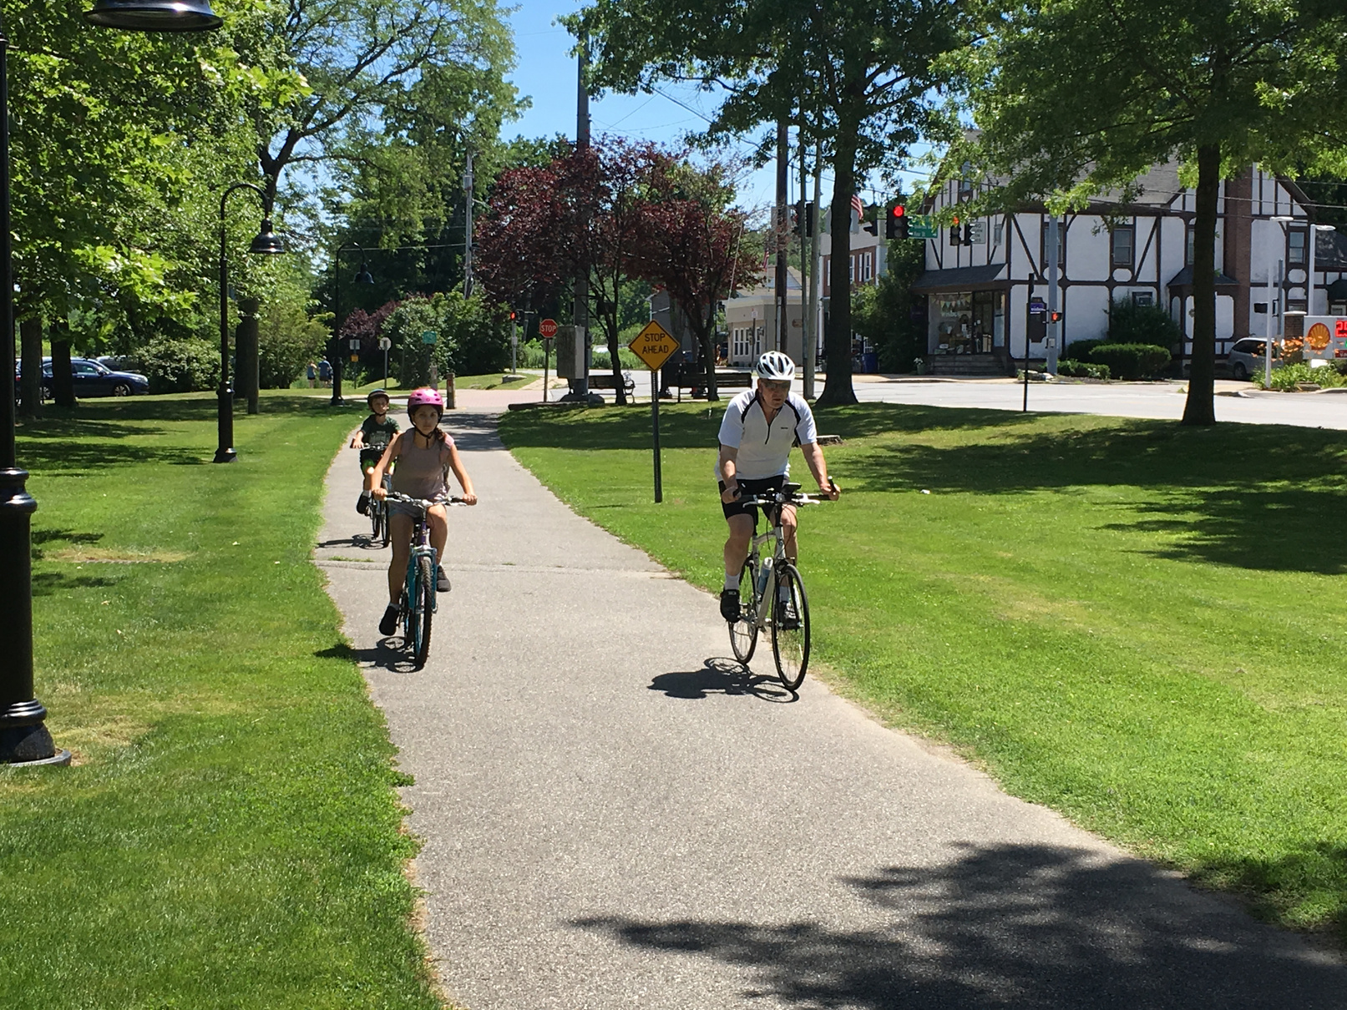
HEALTH BENEFITS
The Empire State Trail turns miles into $78 million in annual health-related savings, by expanding outdoor recreation options and access.
PHYSICAL ACTIVITY HELPS REDUCE MEDICAL COSTS AND INSURANCE PREMIUMS
38% OF USERS DEPEND ON THE TRAIL FOR AT LEAST HALF THEIR WEEKLY EXERCISE
70% OF USERS ENGAGE IN OVER 1 HOUR OF EXERCISE PER VISIT

Slide 31
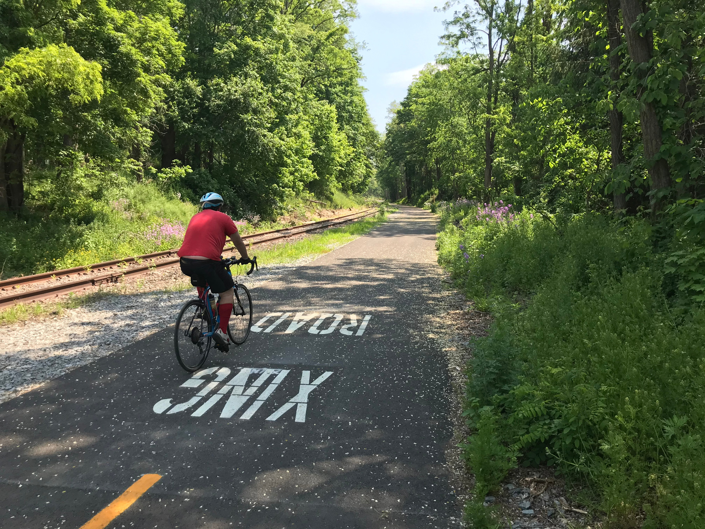

ENVIRONMENTAL BENEFITS
The Empire State Trail preserves 23,300 acres of off-road land, playing a vital role in climate health.
$4.3 MILLION METRIC TONS OF CARBON STORED
REDUCED VEHICLE TRAVEL BY 96 MILLION MILES EACH YEAR
78,000 METRIC TONS OF CARBON REMOVED

Slide 32
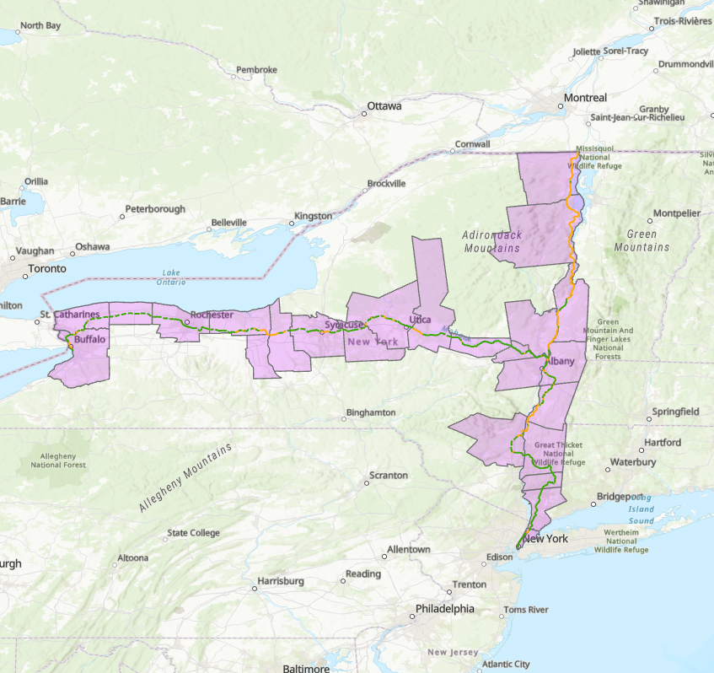
PARTNERS
TOOL
COUNTY-LEVEL DATA

Slide 33
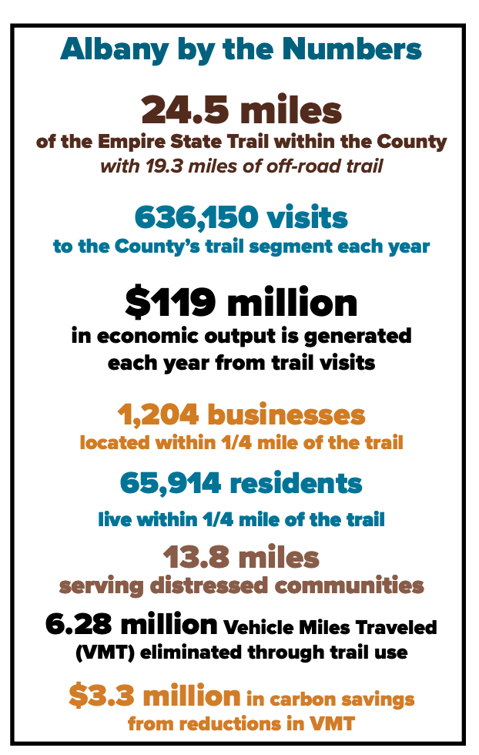
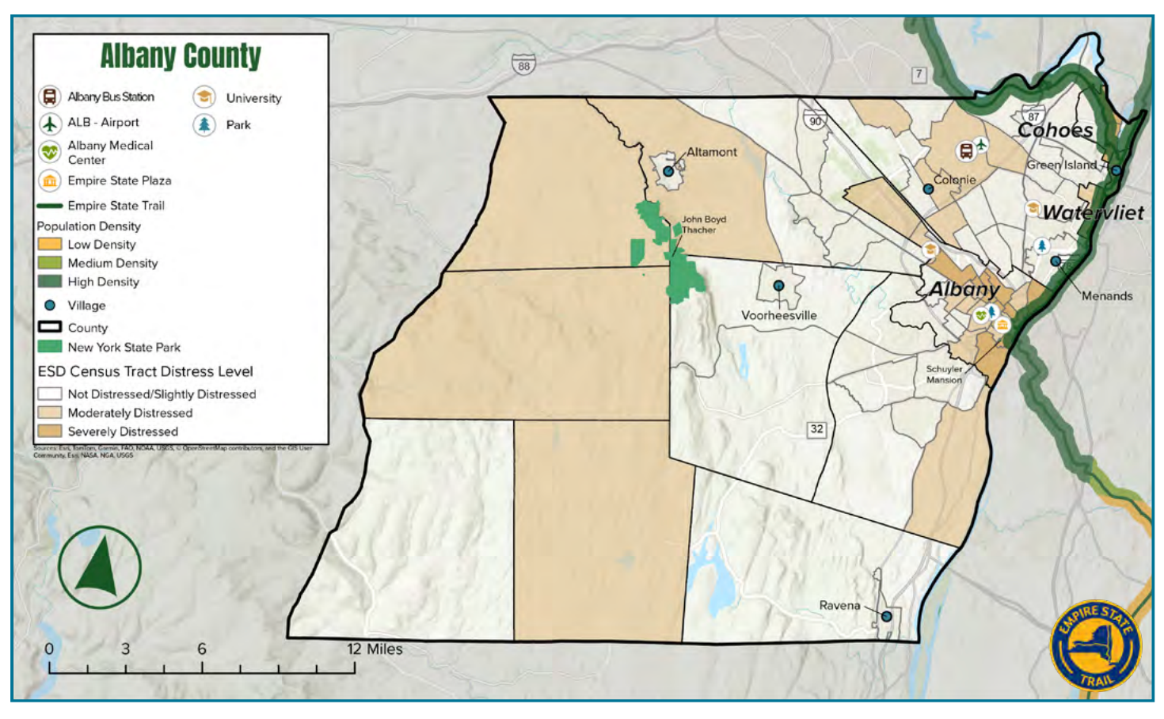
ALBANY COUNTY

Slide 34
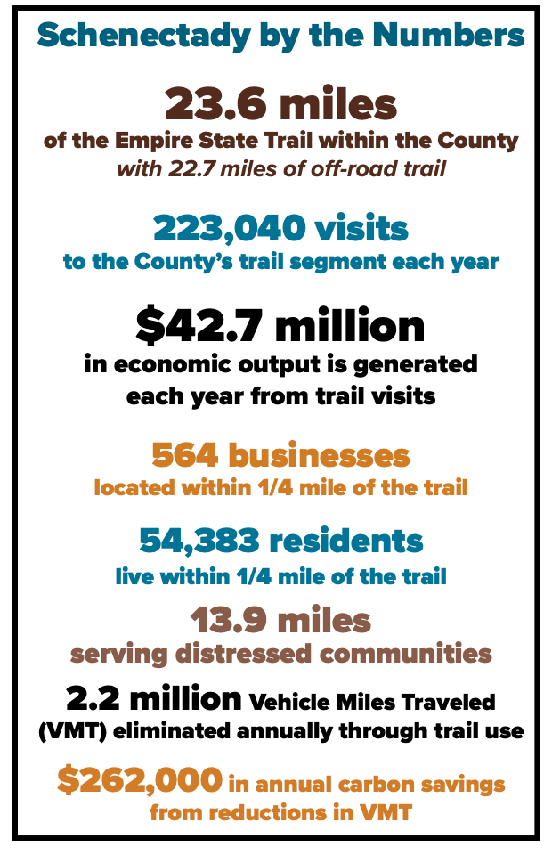
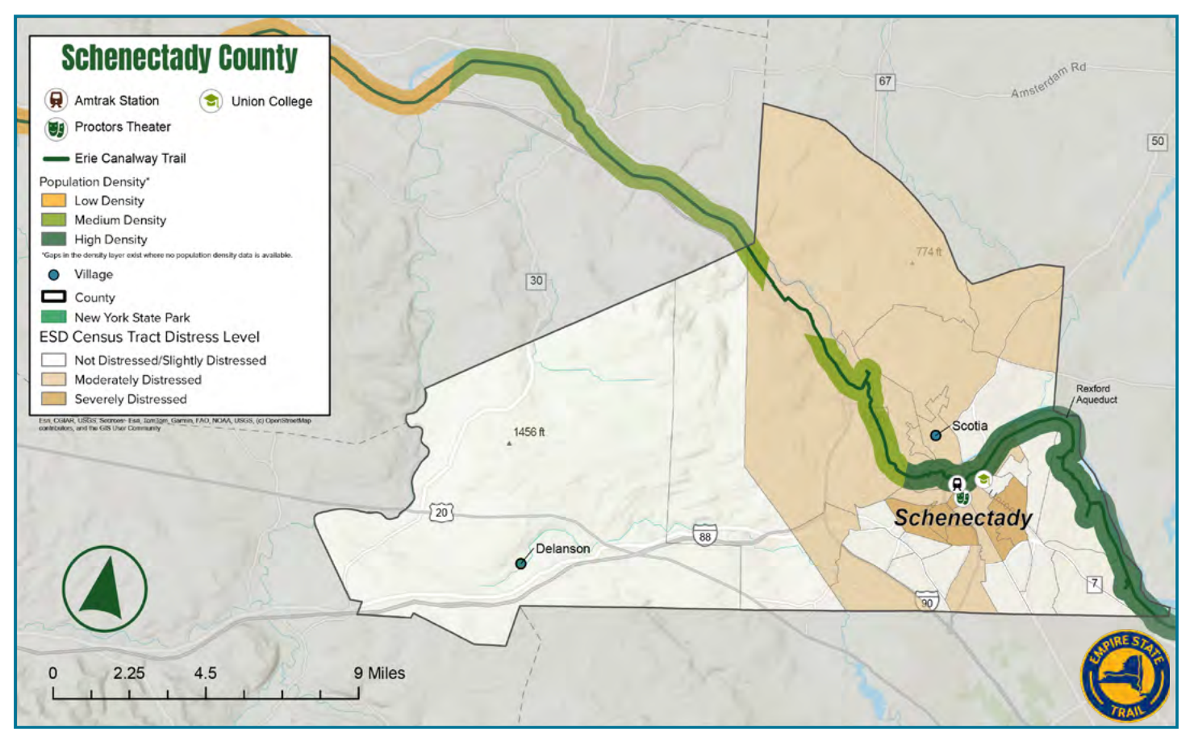
SCHENECTADY COUNTY

Slide 35
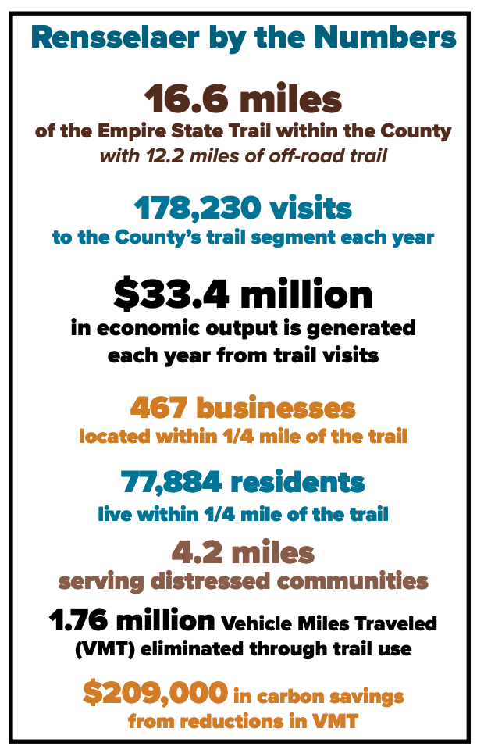
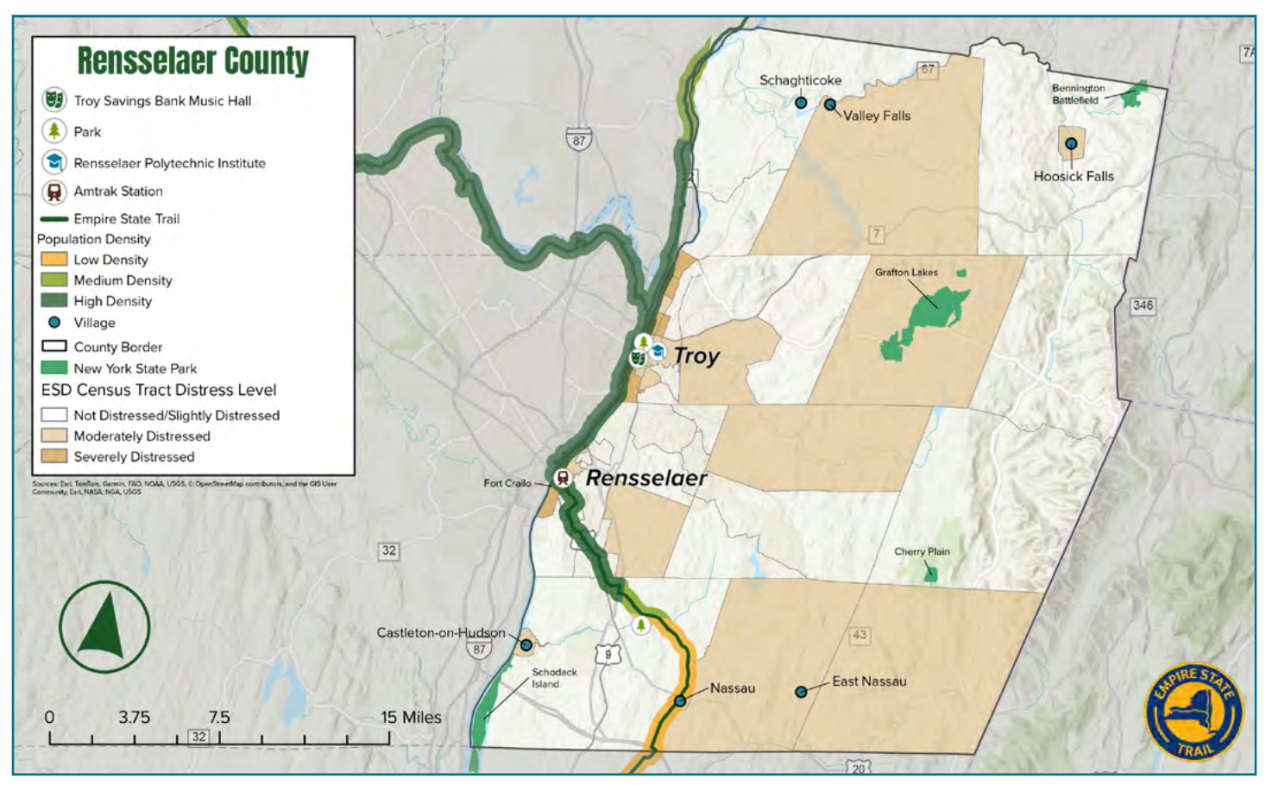
RENSSELAER COUNTY

Slide 36
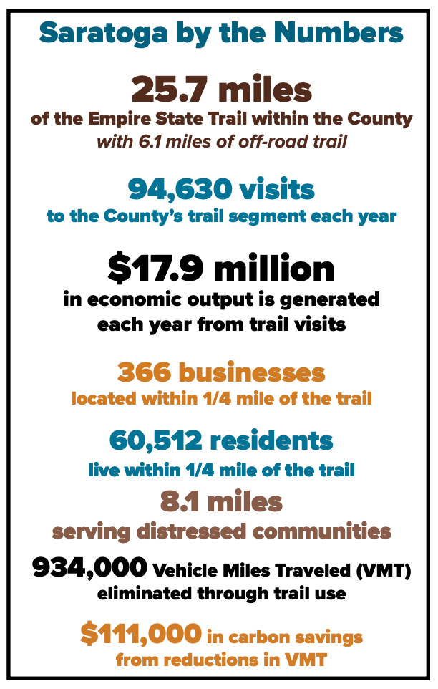
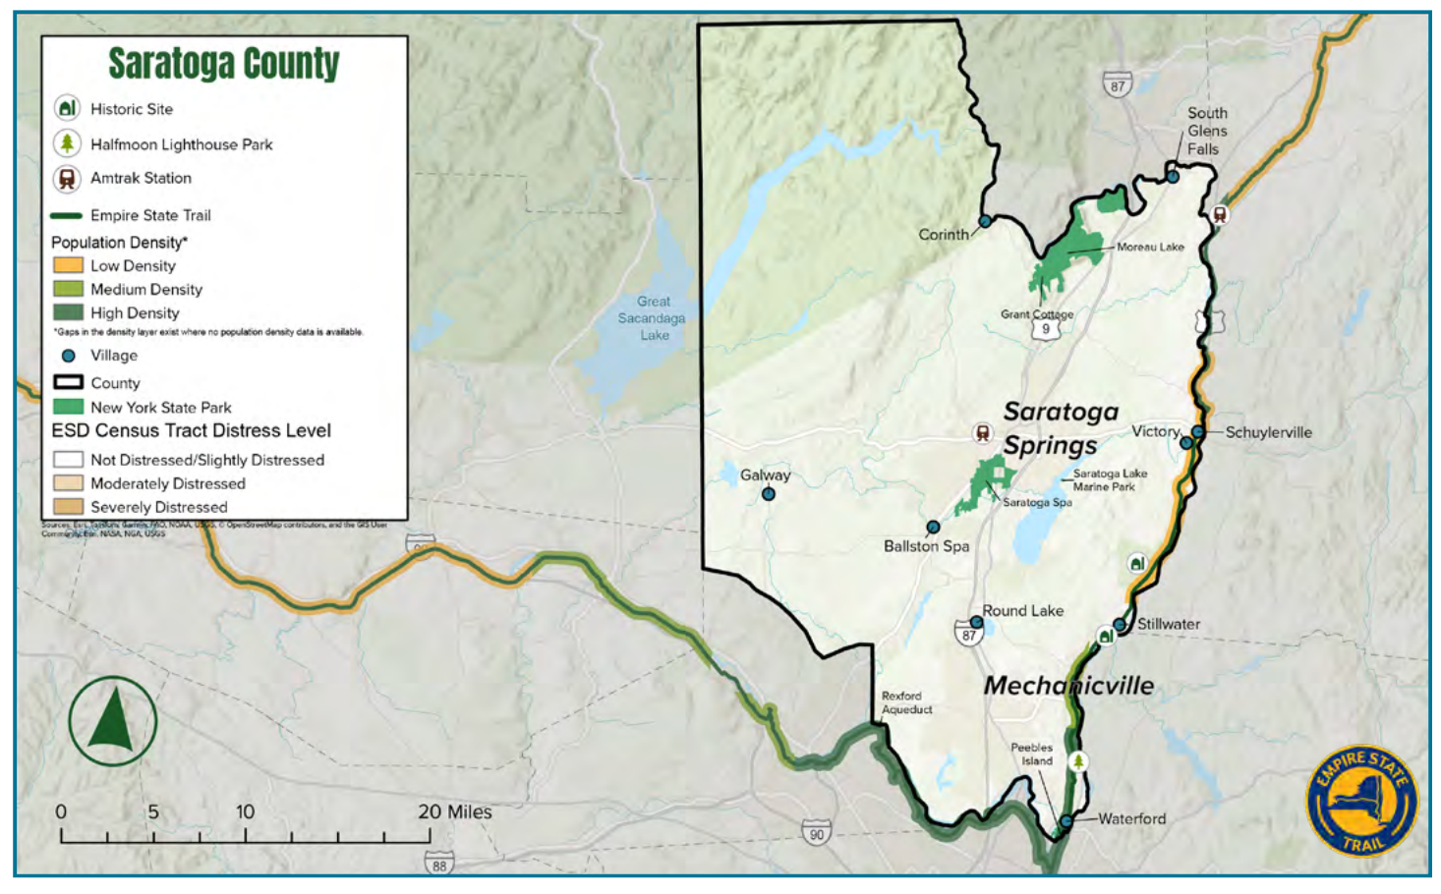
SARATOGA COUNTY

Slide 37
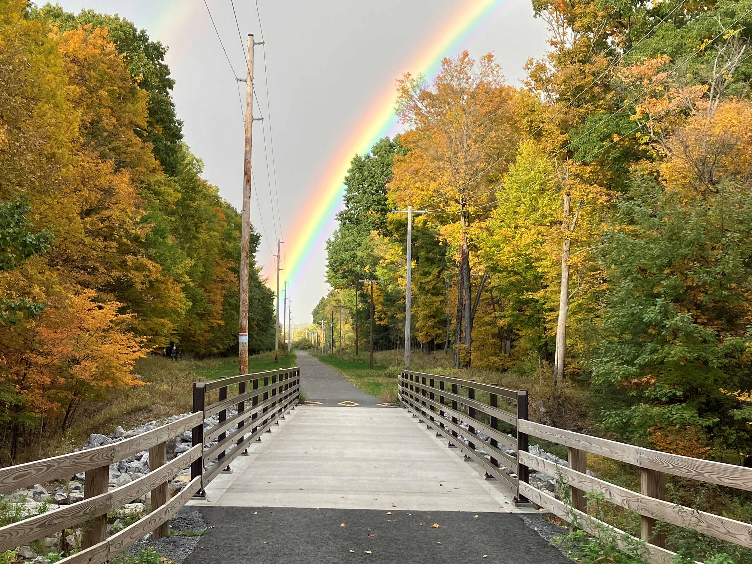
GOOD FOR ECONOMY, HEALTH, OUR COMMUNITIES AND THE ENVIRONMENT.
EVERY DOLLAR INVESTED IN THE TRAIL RETURNED OVER $5 IN ECONOMIC OUTPUT
THE MORE WE INVEST IN OFF-ROAD TRAILS, THE MORE BENEFITS WE CREATE.

Slide 38
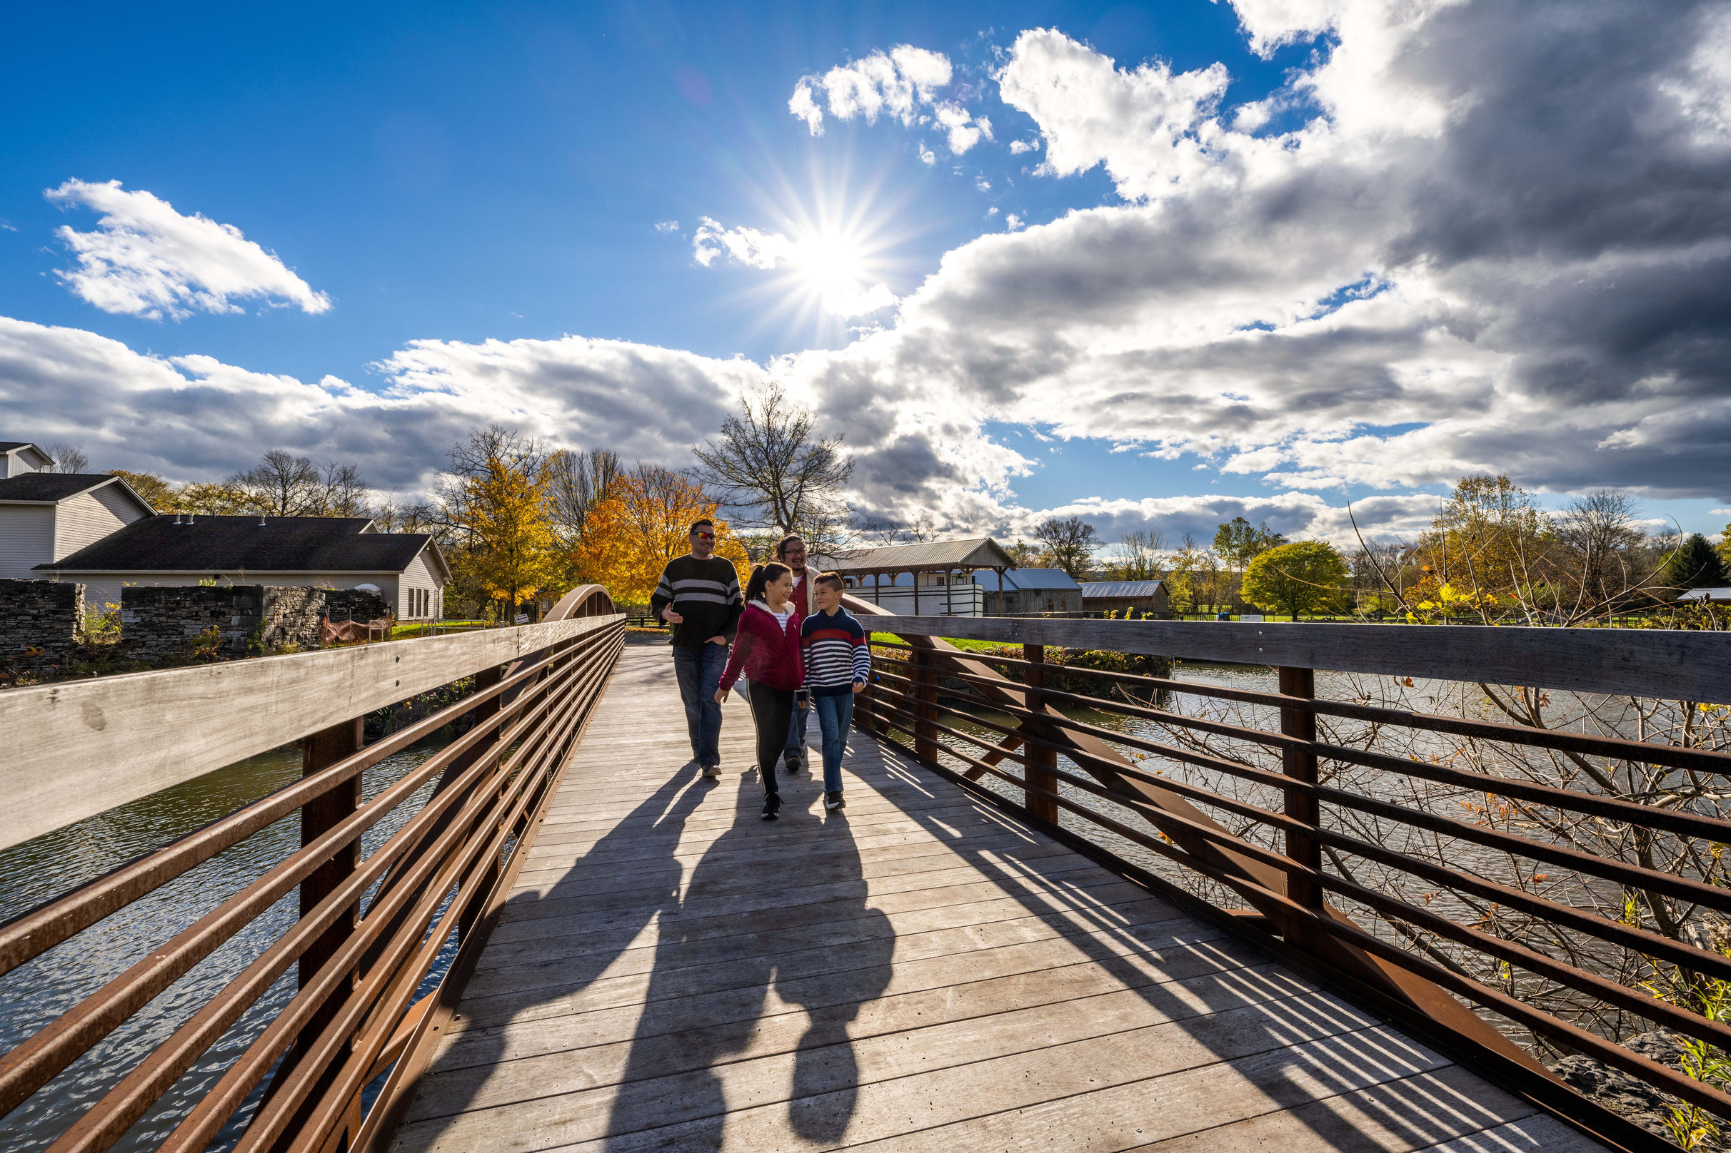
QUESTIONS & DISCUSSION

Slide 39
DISCUSSION ITEMS

Slide 40
2026 Walk, Bike, Roll New York
Symposium Summary
Keynote: Shredders MTB – Bikes in School
Access for All (Interactive Session)
Trail Planning
  Safe and legible movement/transitions necessary
  Parks and trails innately connected
  Plan for most frequent and most vulnerable users
Plenary: E-bike Future
  “Growth without guiderails is not progress”
  Safe SPEEDS Act in Congress
    Standardized classes, speed limits, and safety standards
    E-moto definition

Slide 41
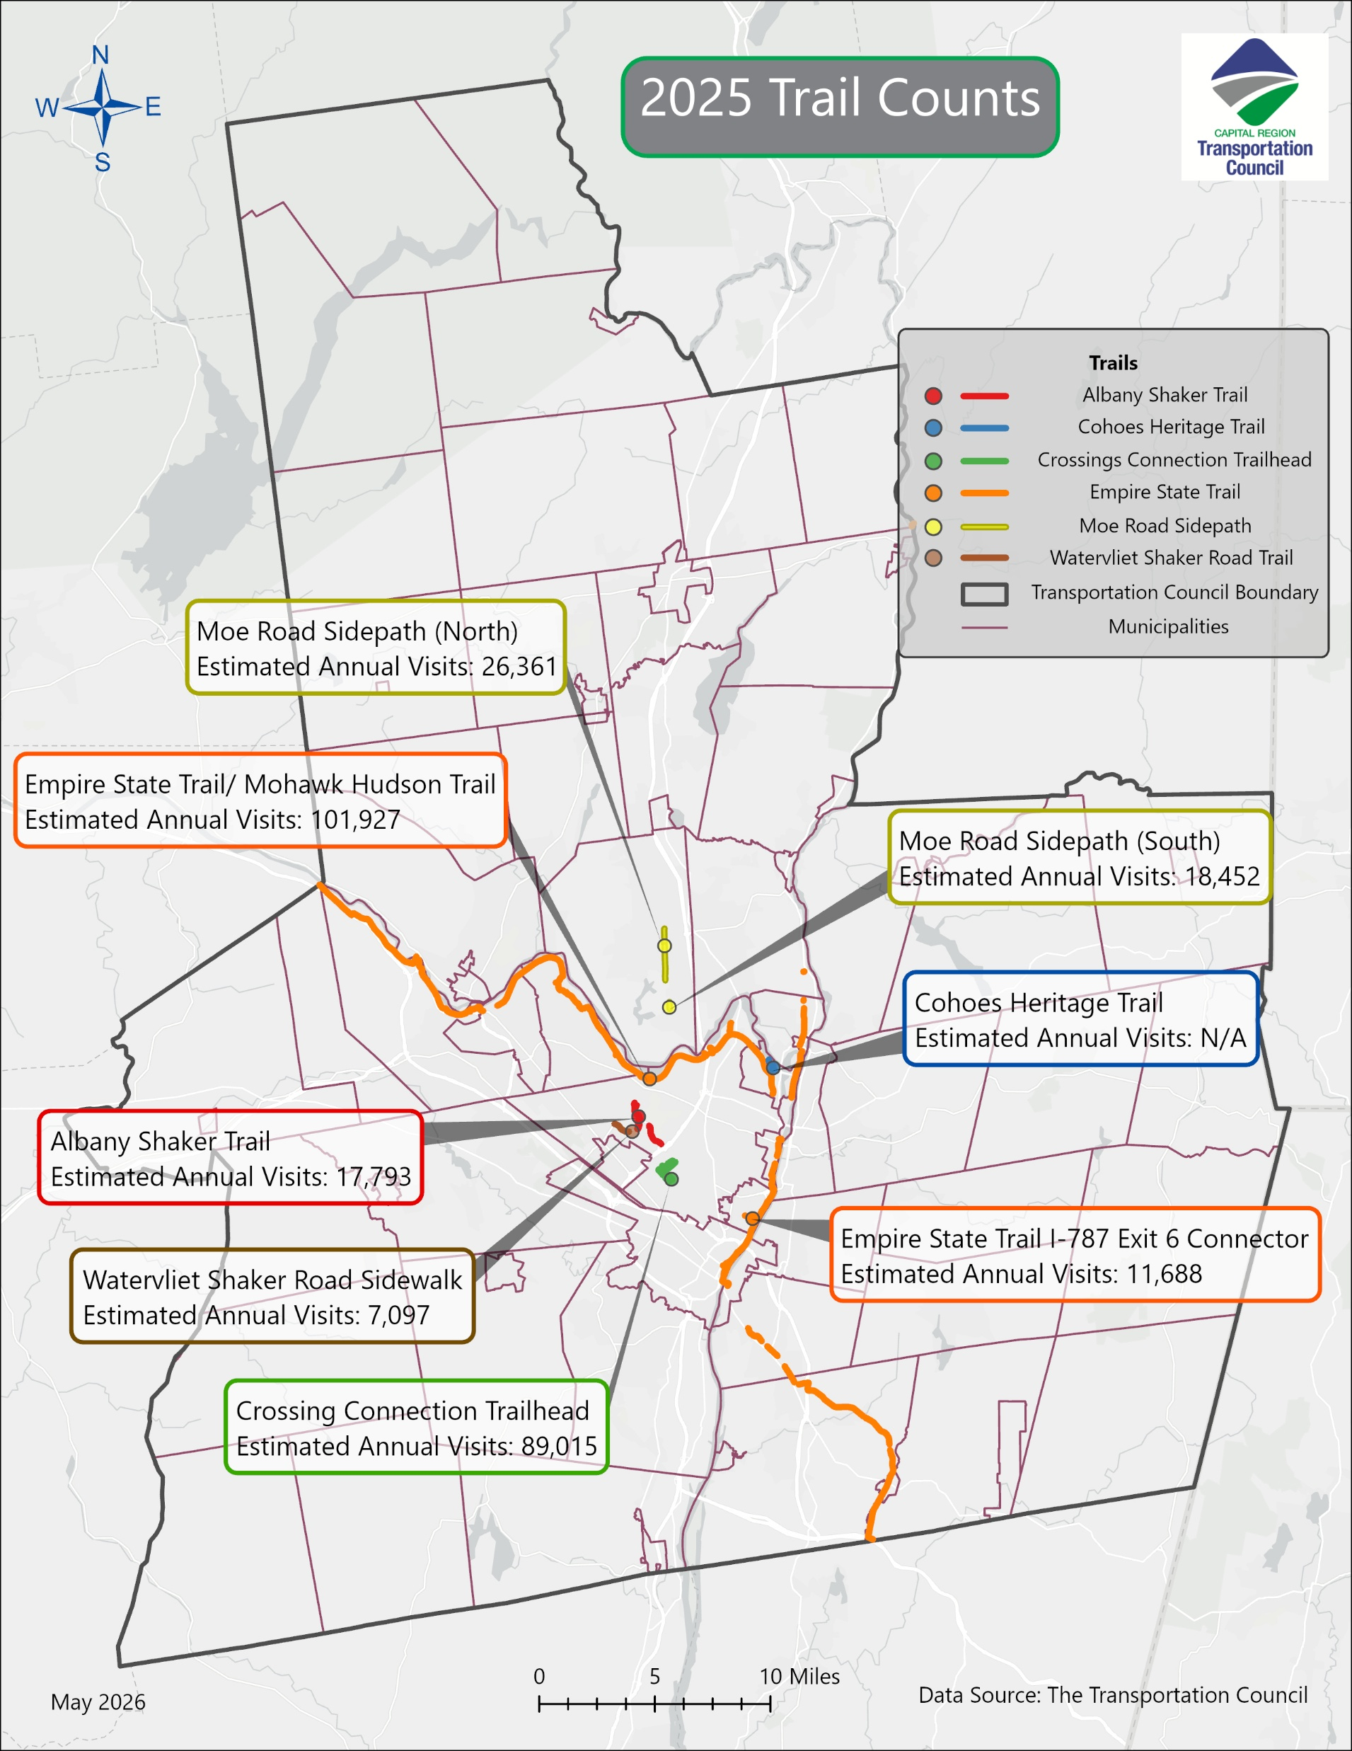
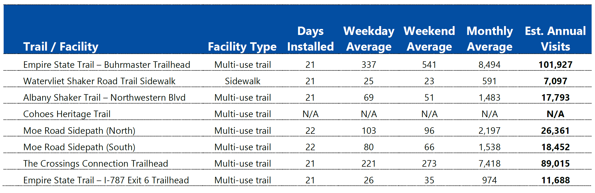
2026 Trail Count Program Report
Report out now!
  Email etownsend@capitalmpo.org
Eight sites counted in 2025
One trail counter stolen
2026 counts ongoing

Slide 42

Hudson River Valley Greenway
Conservancy Trail Grant Program
Trail planning, design, and/or construction
Up to $250,000 for construction
Emphasis on Connections to Empire State Trail
50/50 matching grants (in-kind or cash)
Application Window: July 6 - August 7
Next grant window January/February 2027
https://hrvg.grantplatform.com/

Slide 43
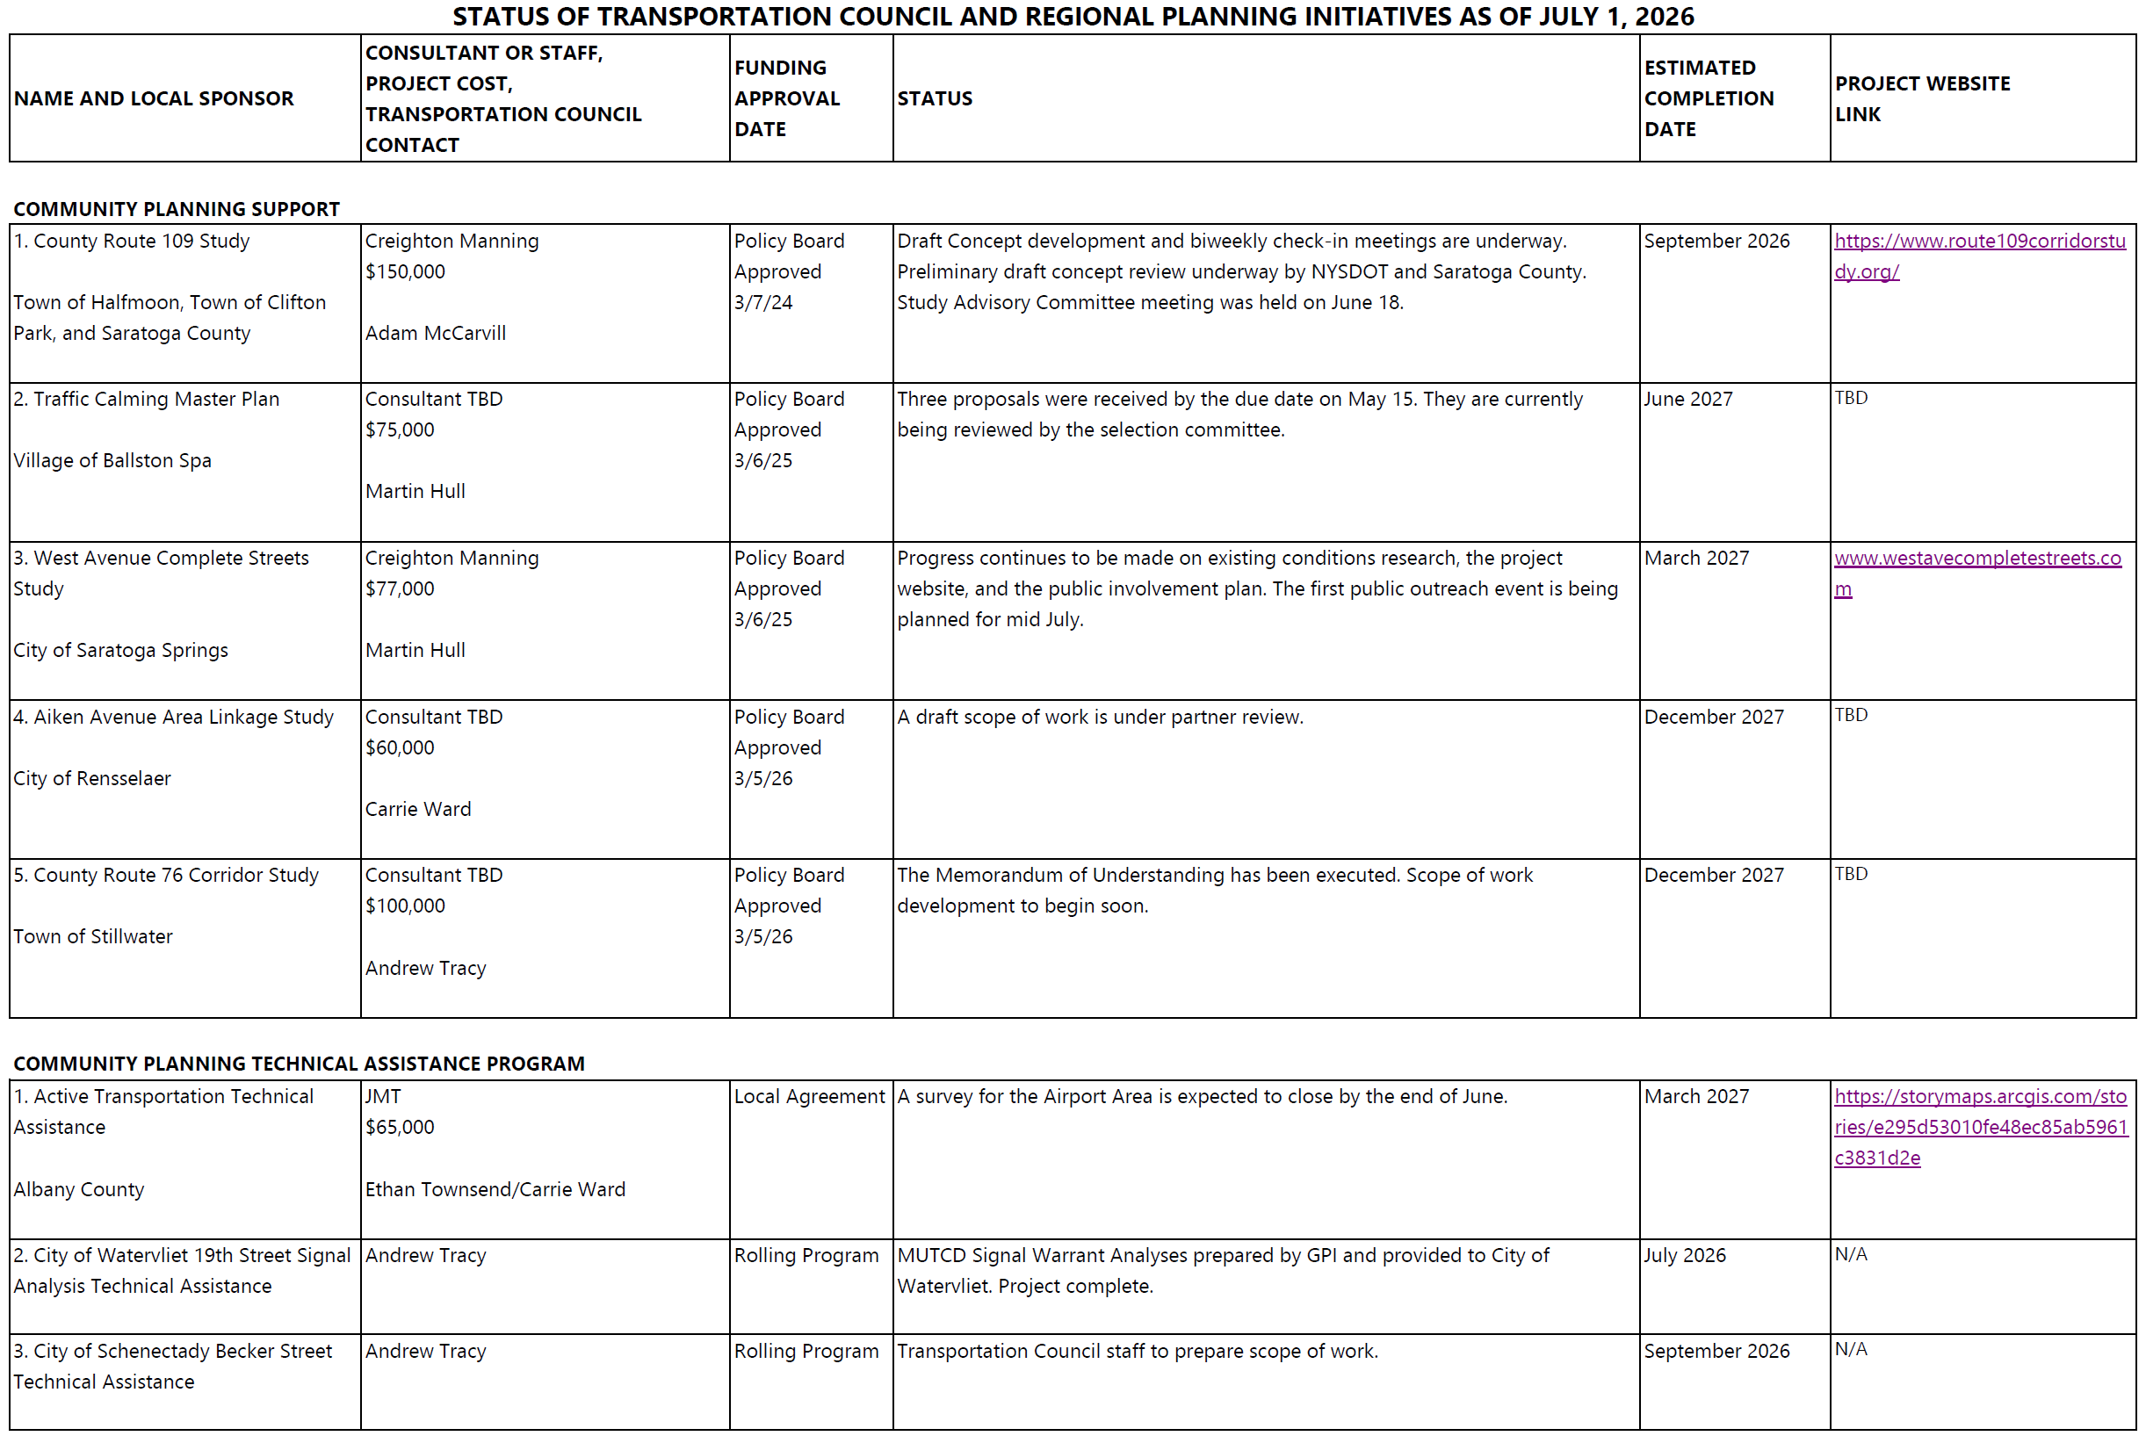

Slide 44
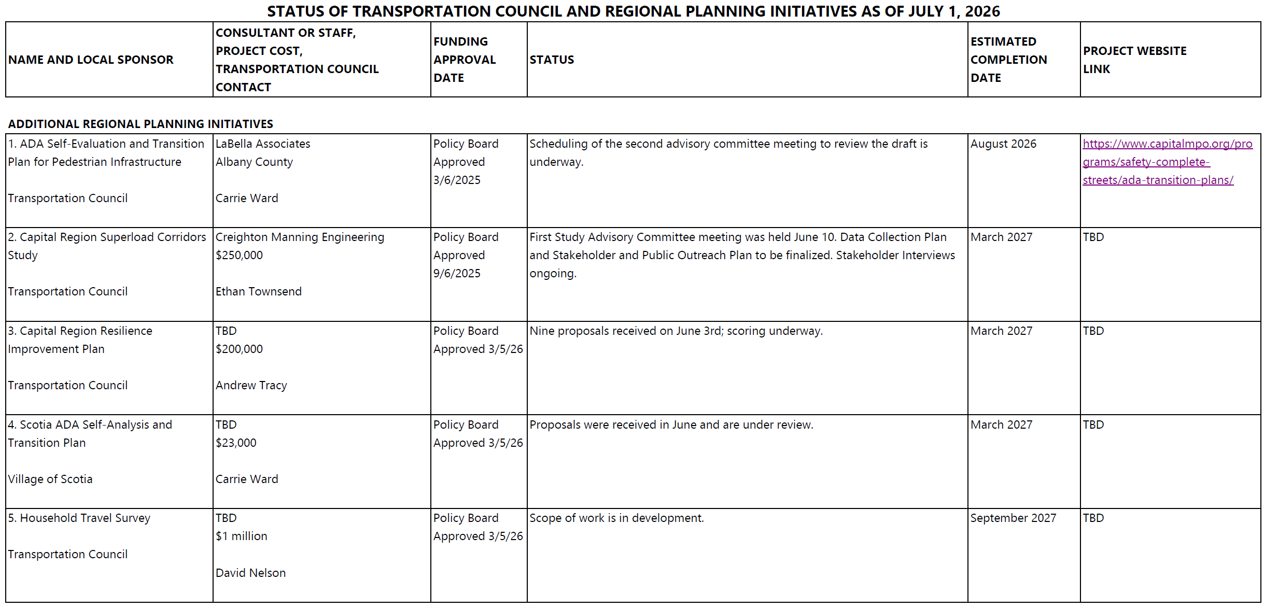

Slide 45
PARTICIPANT UPDATES

Slide 46
UPCOMING MEETINGS

Slide 47
Upcoming Meetings
2026 Meeting Schedule:
October 21, 2026
9:30am

Slide 48





THANK YOU!
Ethan Townsend
Transportation Planner
Sign up for E-News: http://eepurl.com/ivx946
Phone
Email
(518) 458-2161
etownsend@capitalmpo.org
Mail
Web
1 Park Place, Suite 101, Albany, NY 12205-2676
capitalmpo.org
CapitalMPO
@CapiltalMPO
@CapitalMPO
Capital Region Transportation Council

